Slide 1
聖經上的過年
Passover
出埃及記 Exodus 12:1-14

Slide 2
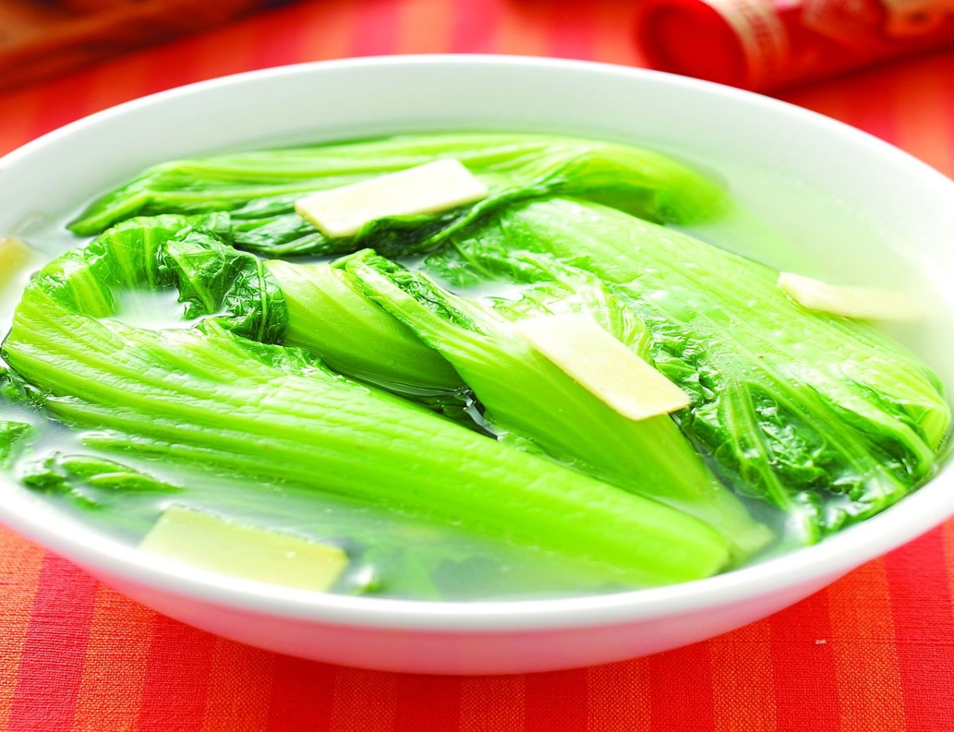

Slide 3
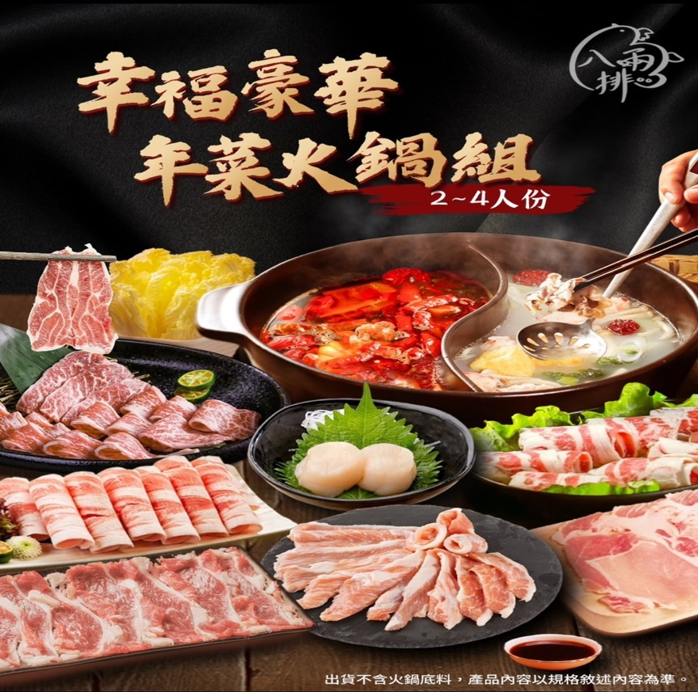

Slide 4
出埃及記 Exodus 12:1-14
1 耶和華在埃及地曉諭摩西、亞倫說：
² 「你們要以本月為正月，為一年之首。
³ 你們吩咐以色列全會眾說：本月初十日，各人要按著父家取羊羔，一家一隻。
The Lord said to Moses and Aaron in Egypt,
2 “This month is to be for you the first month, the first month of your year.
3 Tell the whole community of Israel that on the tenth day of this month each man is to take a lamb for his family, one for each household.

Slide 5
4 If any household is too small for a whole lamb, they must share one with their nearest neighbor, having taken into account the number of people there are. You are to determine the amount of lamb needed in accordance with what each person will eat.
5 The animals you choose must be year-old males without defect, and you may take them from the sheep or the goats.
⁴ 若是一家的人太少，吃不了一隻羊羔，本人就要和他隔壁的鄰舍共取一隻。你們預備羊羔，要按著人數和飯量計算。
⁵ 要無殘疾、一歲的公羊羔，你們或從綿羊裡取，或從山羊裡取，都可以。

Slide 6
⁶ 要留到本月十四日，在黃昏的時候，以色列全會眾把羊羔宰了。
⁷ 各家要取點血，塗在吃羊羔的房屋左右的門框上和門楣上。
6 Take care of them until the fourteenth day of the month, when all the members of the community of Israel must slaughter them at twilight.
7 Then they are to take some of the blood and put it on the sides and tops of the doorframes of the houses where they eat the lambs.

Slide 7
8 That same night they are to eat the meat roasted over the fire, along with bitter herbs, and bread made without yeast.
9 Do not eat the meat raw or boiled in water, but roast it over a fire—with the head, legs and internal organs.
⁸ 當夜要吃羊羔的肉，用火烤了，與無酵餅和苦菜同吃。
⁹ 不可吃生的，斷不可吃水煮的，要帶著頭、腿、五臟，用火烤了吃。

Slide 8
¹⁰ 不可剩下一點留到早晨，若留到早晨，要用火燒了。
¹¹ 你們吃羊羔當腰間束帶，腳上穿鞋，手中拿杖，趕緊地吃。這是耶和華的逾越節。
10 Do not leave any of it till morning; if some is left till morning, you must burn it.
11 This is how you are to eat it: with your cloak tucked into your belt, your sandals on your feet and your staff in your hand. Eat it in haste; it is the Lord’s Passover.

Slide 9
¹² 因為那夜我要巡行埃及地，把埃及地一切頭生的，無論是人是牲畜，都擊殺了，又要敗壞埃及一切的神。我是耶和華。
12 “On that same night I will pass through Egypt and strike down every firstborn of both people and animals, and I will bring judgment on all the gods of Egypt. I am the Lord.

Slide 10
¹³ 這血要在你們所住的房屋上做記號，我一見這血，就越過你們去，我擊殺埃及地頭生的時候，災殃必不臨到你們身上滅你們。
¹⁴ 你們要記念這日，守為耶和華的節，作為你們世世代代永遠的定例。
13 The blood will be a sign for you on the houses where you are, and when I see the blood, I will pass over you. No destructive plague will touch you when I strike Egypt.
14 “This is a day you are to commemorate; for the generations to come you shall celebrate it as a festival to the Lord—a lasting ordinance.

Slide 11
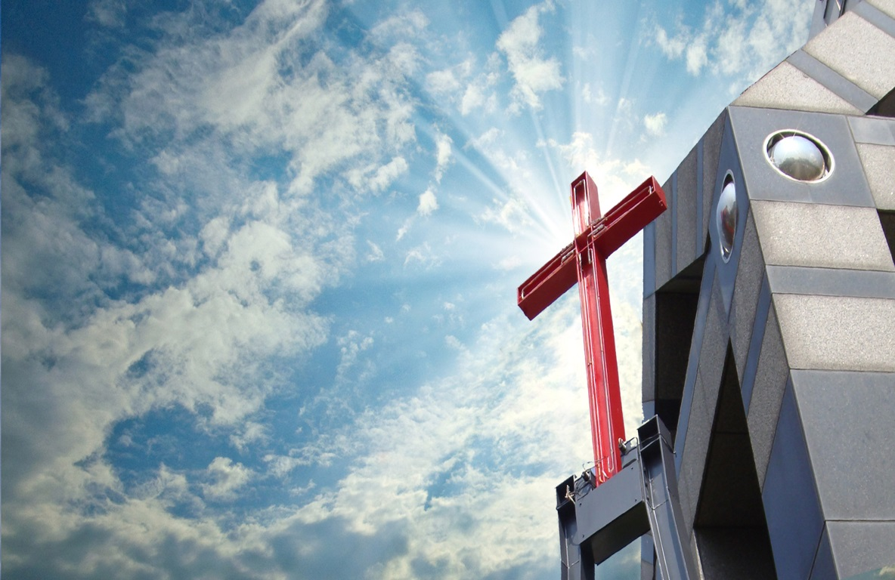
台北大直長老教會

Slide 12
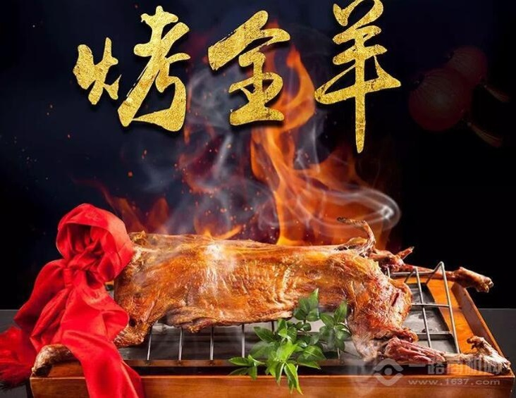

Slide 13
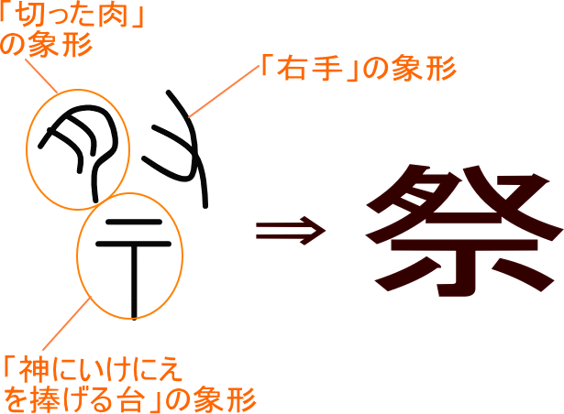

Slide 14
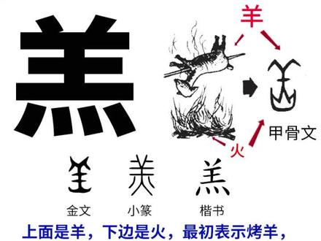

Slide 15
以弗所書 Ephesians 6
14 要穿戴神所賜的全副軍裝，所以要站穩了，用真理當做帶子束腰，
¹⁵ 又用平安的福音當做預備走路的鞋穿在腳上。並戴上救恩的頭盔，拿著聖靈的寶劍，就是神的道】
14 Stand firm then, with the belt of truth buckled around your waist, with the breastplate of righteousness in place,
15 and with your feet fitted with the readiness that comes from the gospel of peace.

Slide 16
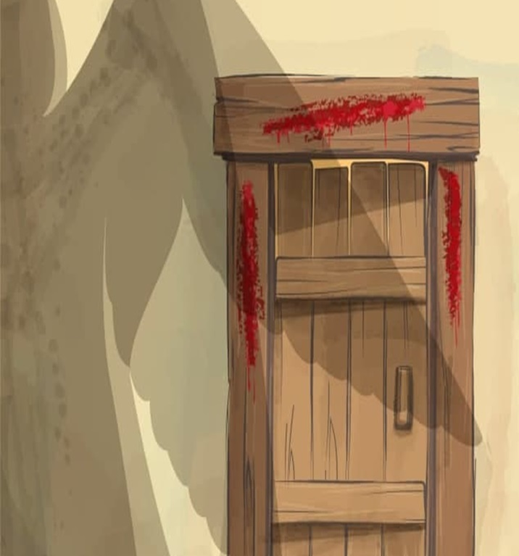
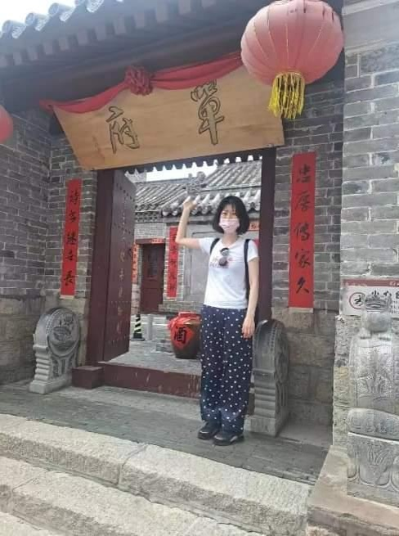

Slide 17
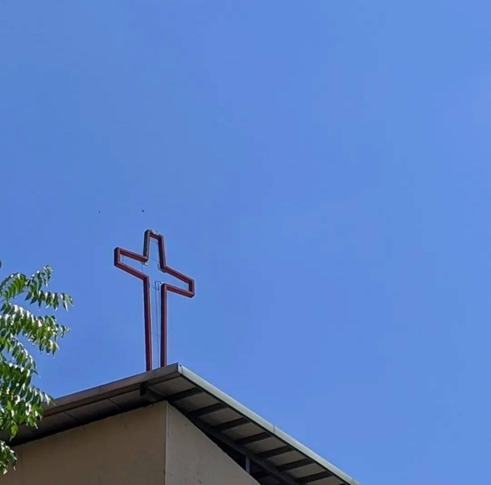
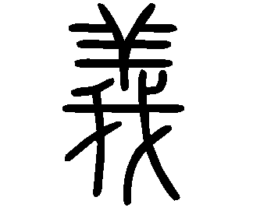
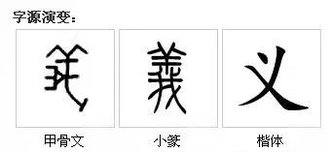
因信稱義

Slide 18
神愛世人，甚至將他的獨生子賜給他們，叫一切信他的 ，不至滅亡，反得永生。
For God so loved the world that he gave his one and only Son, that whoever believes in him shall not perish but have eternal life.
約翰福音 John 3：16

