Slide 1
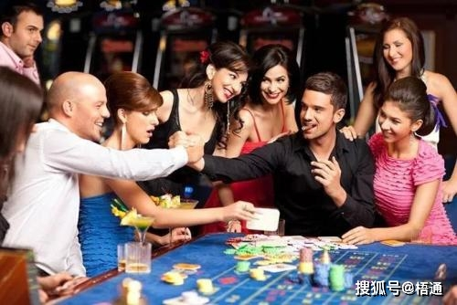

Slide 2
勝過試探
Overcome the Temptation
馬太 4：1-11

Slide 3
馬太 4：1-11
1 當時、耶穌被聖靈引到曠野、受魔鬼的試探。 2 他禁食四十晝夜、後來就餓了。 3 那試探人的進前來、對他說、你若是神的兒子、可以吩咐這些石頭變成食物。
1 Then Jesus was led by the Spirit into the wilderness to be tempted[a] by the devil.
2 After fasting forty days and forty nights, he was hungry.
3 The tempter came to him and said, “If you are the Son of God, tell these stones to become bread.”

Slide 4
4 耶穌卻回答說、經上記著說、『人活著、不是單靠食物、乃是靠 神口裡所出的一切話。』
5 魔鬼就帶他進了聖城、叫他站在殿頂上、
4 Jesus answered, “It is written: ‘Man shall not live on bread alone, but on every word that comes from the mouth of God.
5 Then the devil took him to the holy city and had him stand on the highest point of the temple.

Slide 5
6 對他說、你若是神的兒子、可以跳下去．因為經上記著說、『主要為你吩咐他的使者、用手托著你、免得你的腳碰在石頭上。』 7 耶穌對他說、經上又記著說、『不可試探主你的 神。』
6 “If you are the Son of God,” he said, “throw yourself down. For it is written:“‘He will command his angels concerning you, and they will lift you up in their hands, so that you will not strike your foot against a stone.’”
7 Jesus answered him, “It is also written: ‘Do not put the Lord your God to the test.

Slide 6
8 魔鬼又帶他上了一座最高的山、將世上的萬國、與萬國的榮華、都指給他看、
9 對他說、你若俯伏拜我、我就把這一切都賜給你。
8 Again, the devil took him to a very high mountain and showed him all the kingdoms of the world and their splendor.
9 “All this I will give you,” he said, “if you will bow down and worship me.”

Slide 7
10 耶穌說、撒但退去罷。〔撒但 就是抵擋的意思乃魔鬼的別名〕因為經上記著說、『當拜主你的 神、單要事奉他。』
11 於是魔鬼離了耶穌 、有天使來伺候他。
10 Jesus said to him, “Away from me, Satan! For it is written: ‘Worship the Lord your God, and serve him only.’”
11 Then the devil left him, and angels came and attended him.

Slide 8
神的兒女 vs 平凡人
迷惑你的自我價值
Confuse your self-esteem

Slide 9
生命的力量是靠著神的話語
Living Power comes from The Living Word of God.

Slide 10
詩篇91：11
因他要為你吩咐他的使者、在你行的一切道路上保護你。12 他們要用手托著你、免得你的腳碰在石頭上】。
For he will command his angels concerning you to guard you in all your ways;

Slide 11
在信仰中找到自己的人生方向和定位
Find your Anchor and Destiny.

Slide 12
控告 Accuse
否定 Deny

Slide 13
身體的試探 （身）
屬靈的試探（靈）
虛榮的試探（心）

Slide 14
依靠神的應許
單純的相信
敬拜事奉的生活
得勝的方法

Slide 15
創世紀 3：6
於是女人見那棵樹的果子好作食物¹、也悅人的眼目²、且是可喜愛的、能使人有智慧³、就摘下果子來喫了．又給他丈夫、他丈夫也喫了。

Slide 16
你是我的一切 You are my all in all 1/6
你是我依靠的力量
你是我尋求的寶藏
你是我的一切
You are my strength when I am weak You are the treasure that I seek You are my all in all

Slide 17
2/6
你好比貴重的珍寶
我怎能放棄你不要
你是我的一切
Seeking You as a precious jewel Lord, to give up I’d be a fool You are my all in all

Slide 18
3/6
耶穌 神羔羊 配得大讚美
耶穌 神羔羊 配得大讚美
Jesus, Lamb of God Worthy is Your name Jesus, Lamb of God Worthy is Your name

Slide 19
4/6
你洗淨我一切罪孽 挪去我所有的羞愧 你是我的一切
Taking my sin, my cross, my shame
Rising again, I bless Your name
You are my all in all

Slide 20
5/6
When I fall down, You pick me up 當我失腳你扶起我 When I am dry, You fill my cup 當我飢渴你充滿我 You are my all in all 你是我的一切

Slide 21
6/6
耶穌 神羔羊 配得大讚美
耶穌 神羔羊 配得大讚美
Jesus, Lamb of God Worthy is Your name Jesus, Lamb of God Worthy is Your name

