Slide 1
Sending peace and love
經歷異象的實現
Madagascar Vision & Mission
4/27/2025 update

Slide 5
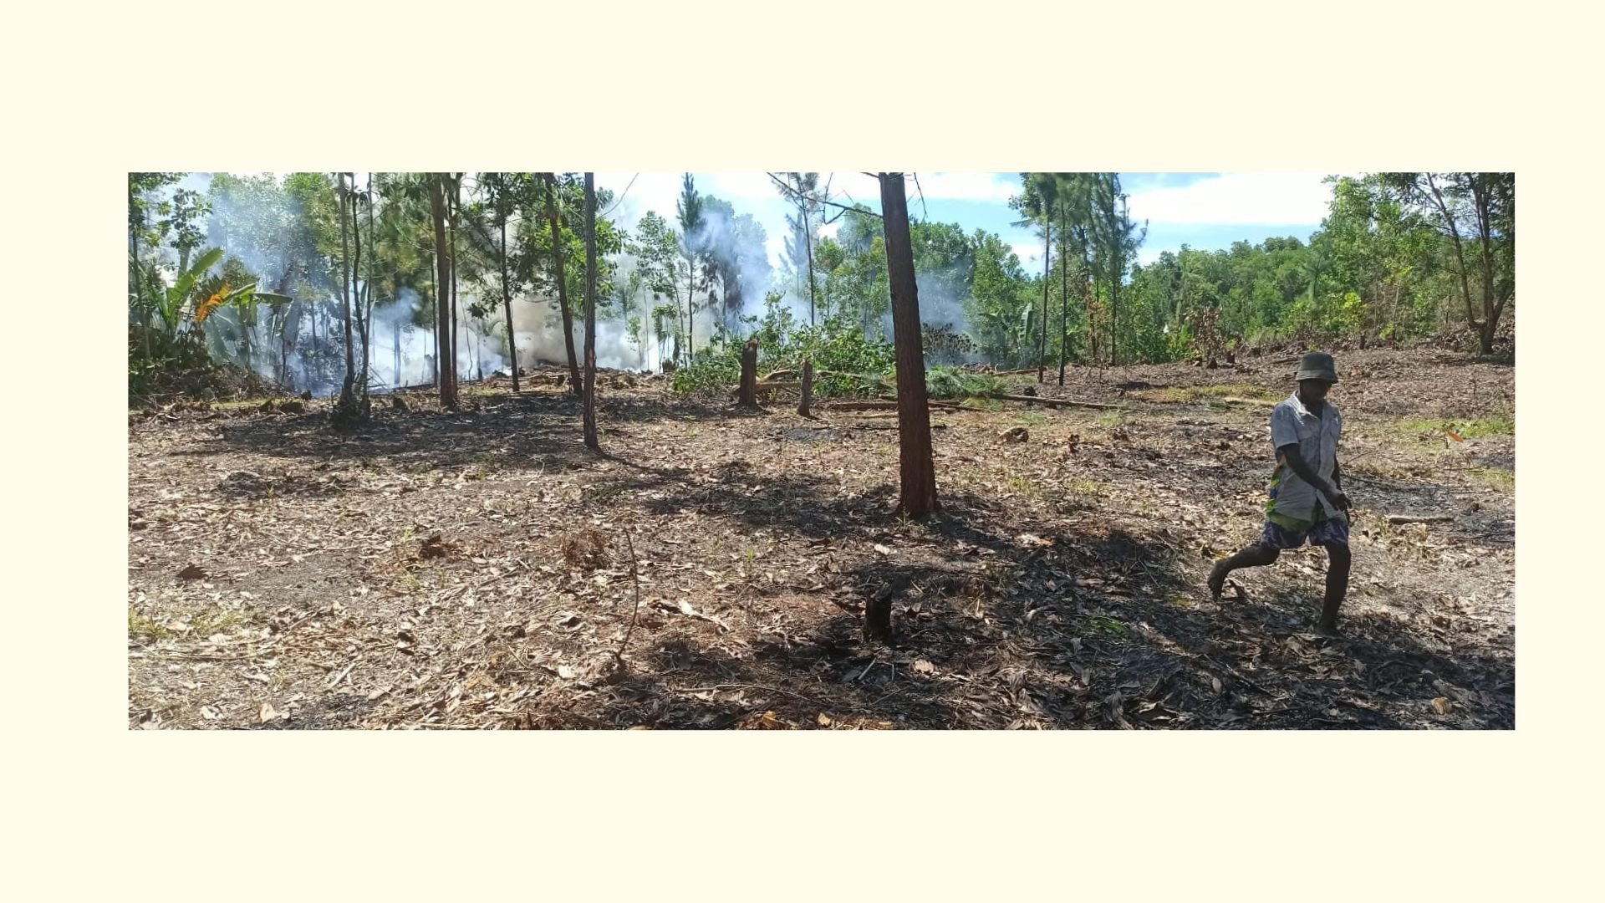

Slide 6
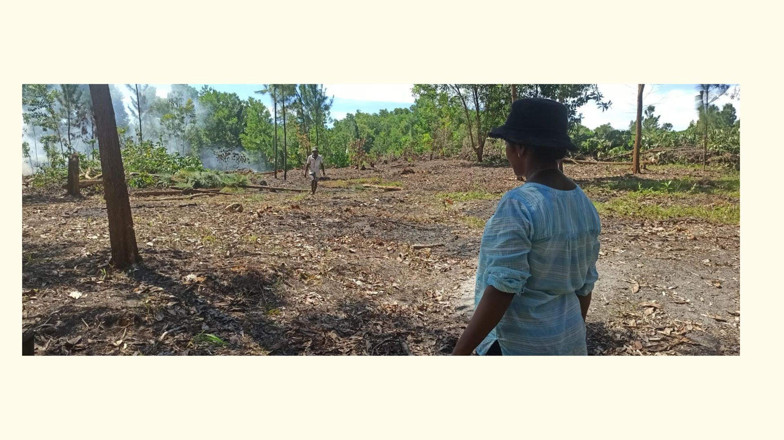

Slide 7
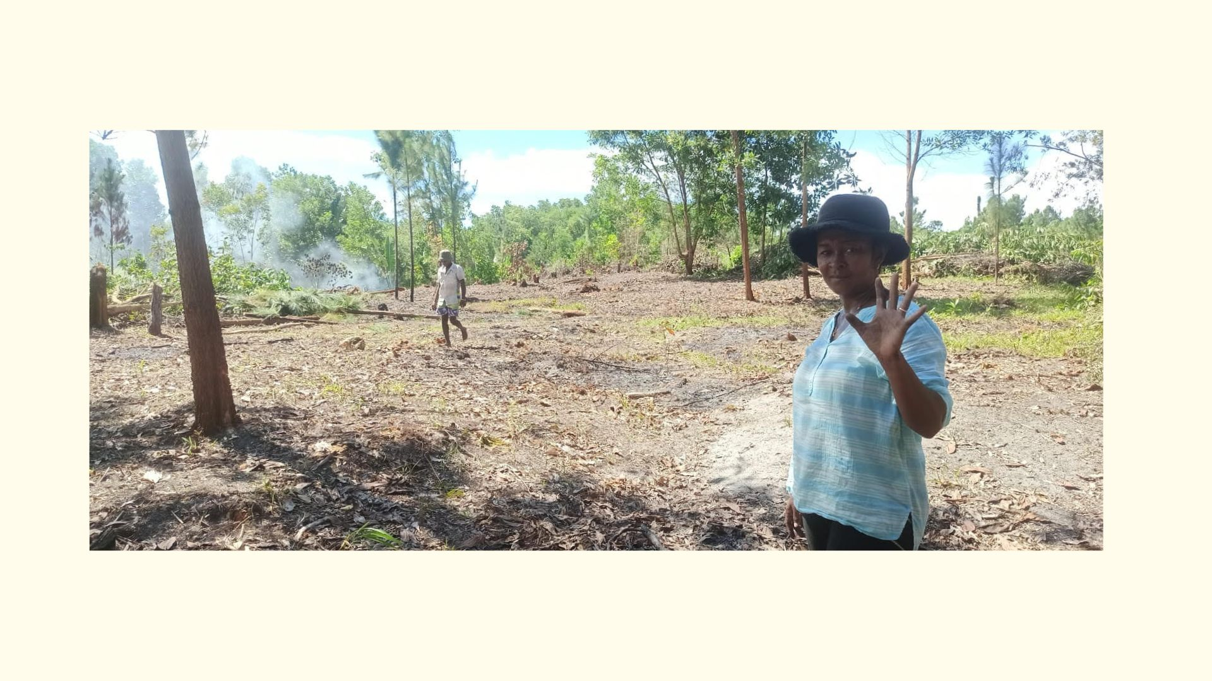

Slide 8
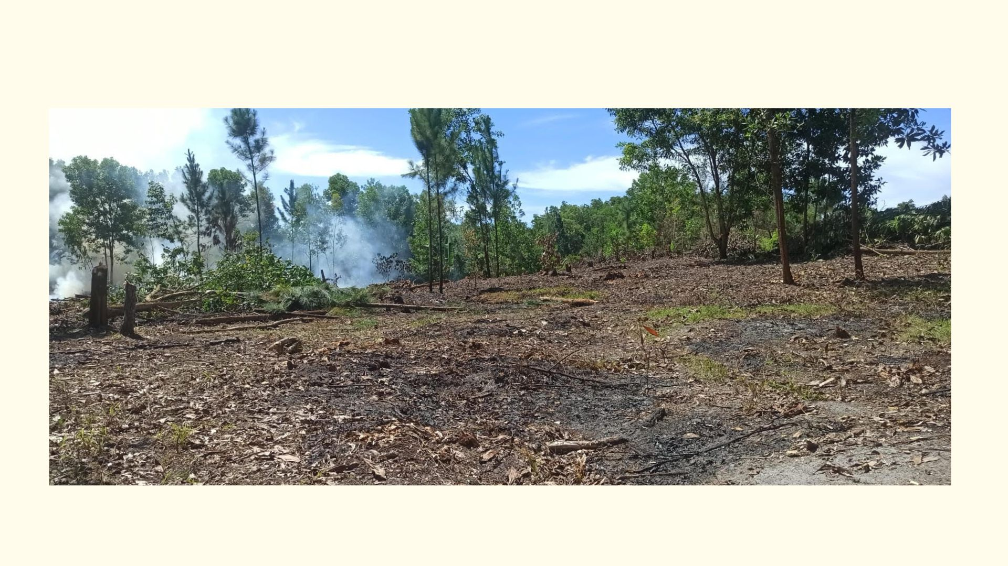

Slide 9
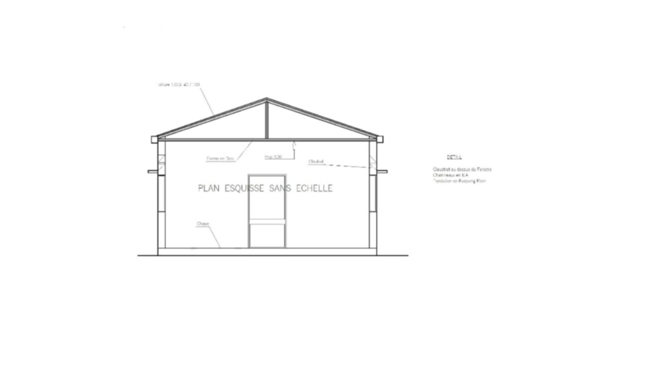

Slide 10
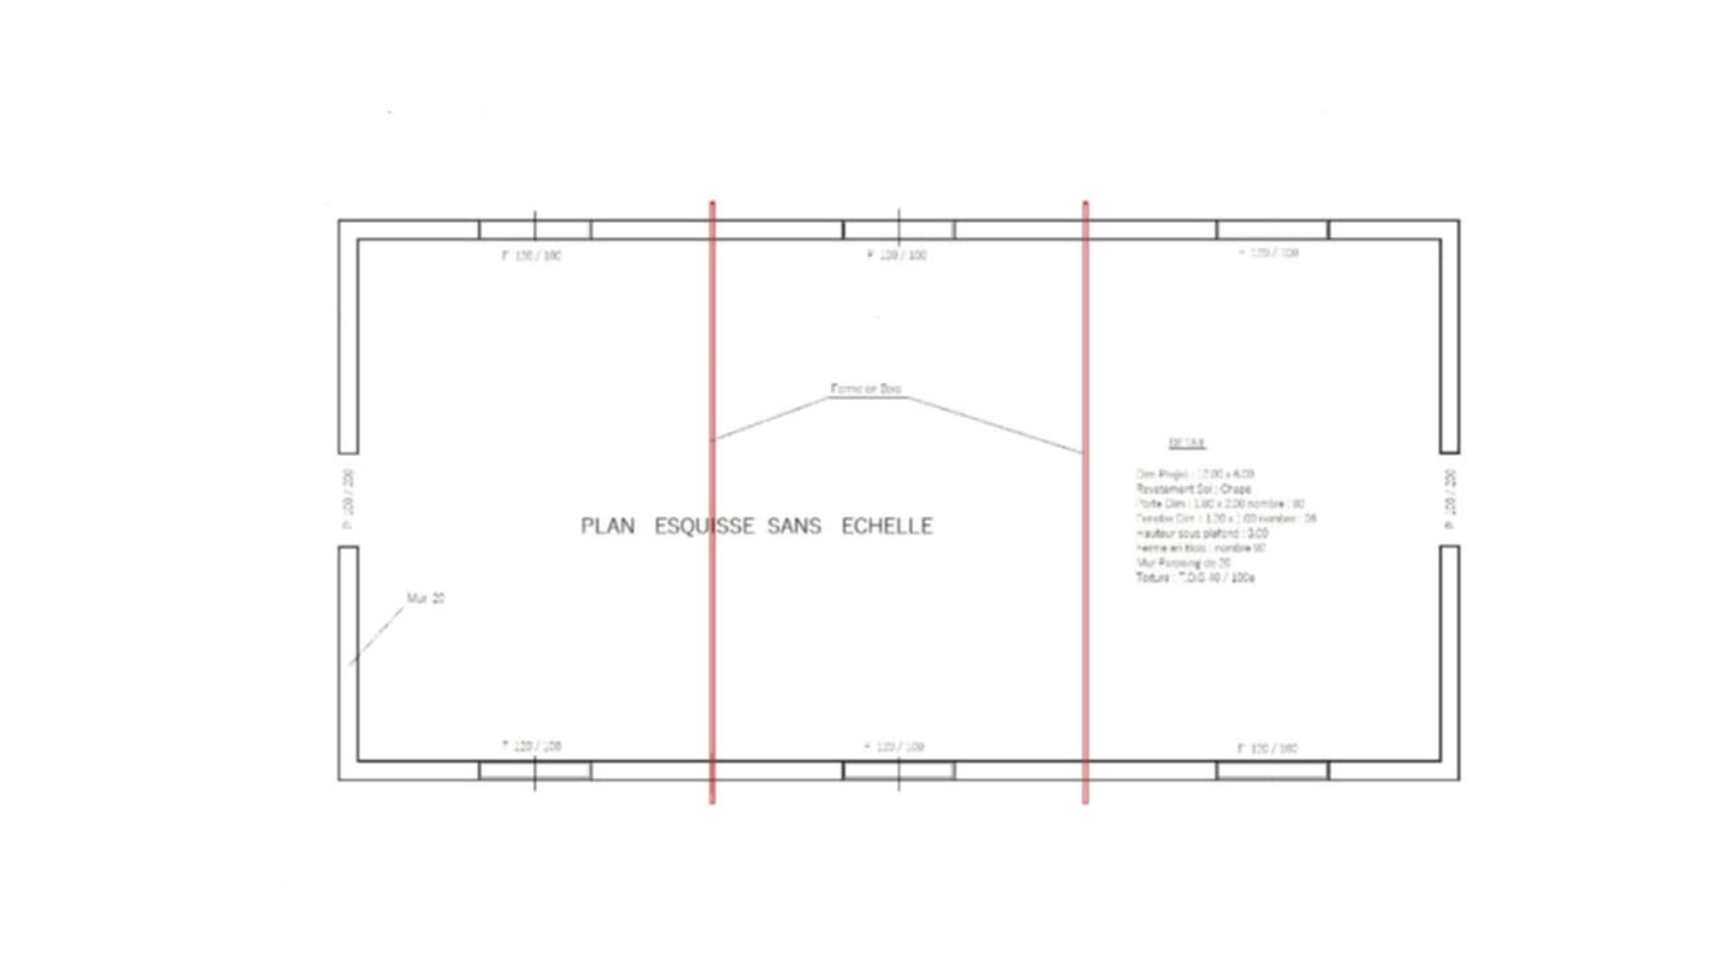

Slide 12
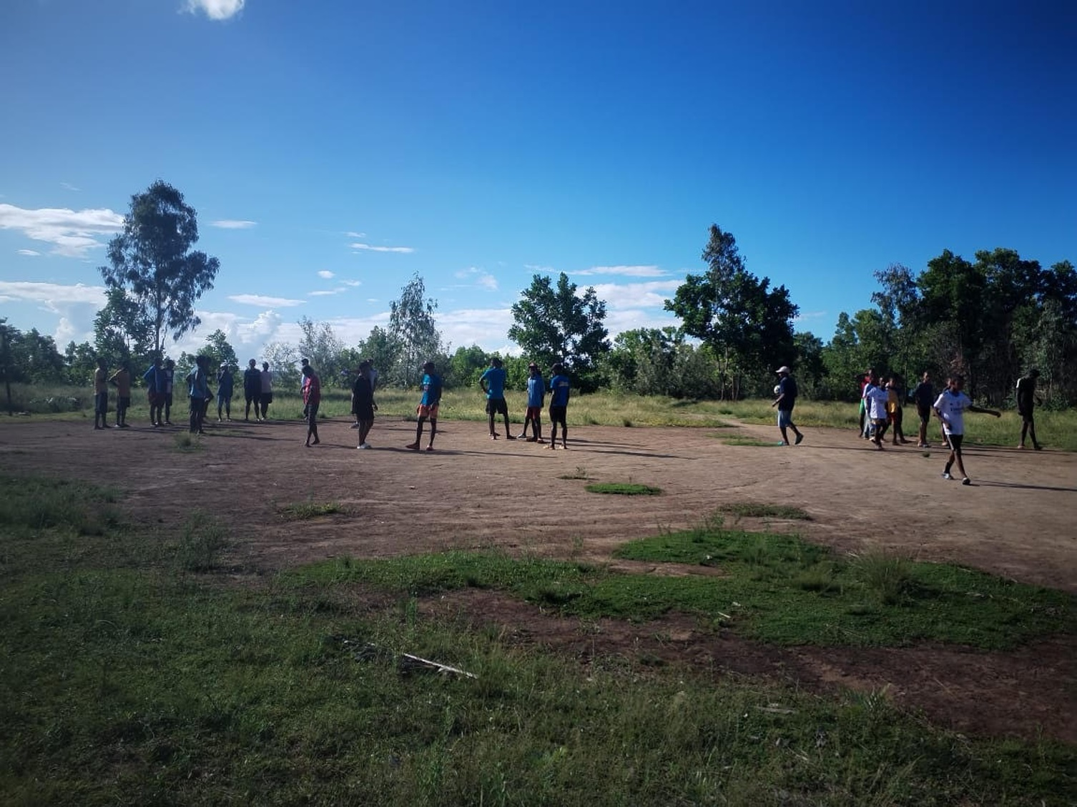
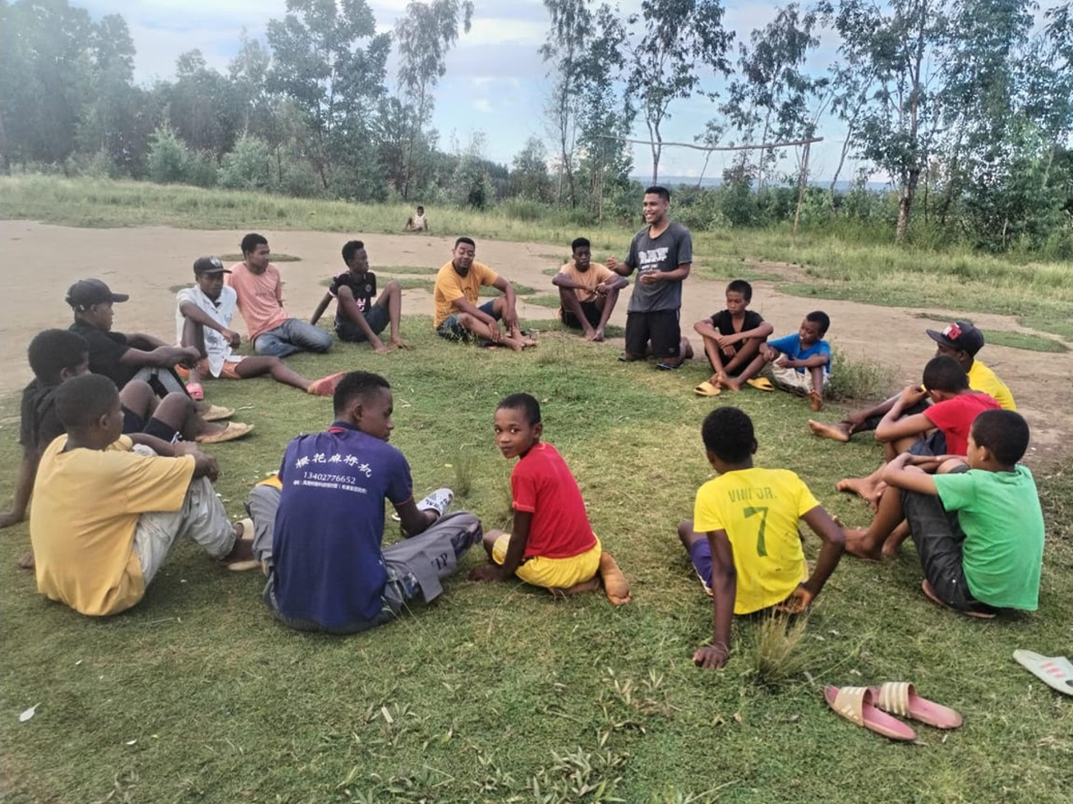
Andohanako Village

Slide 13
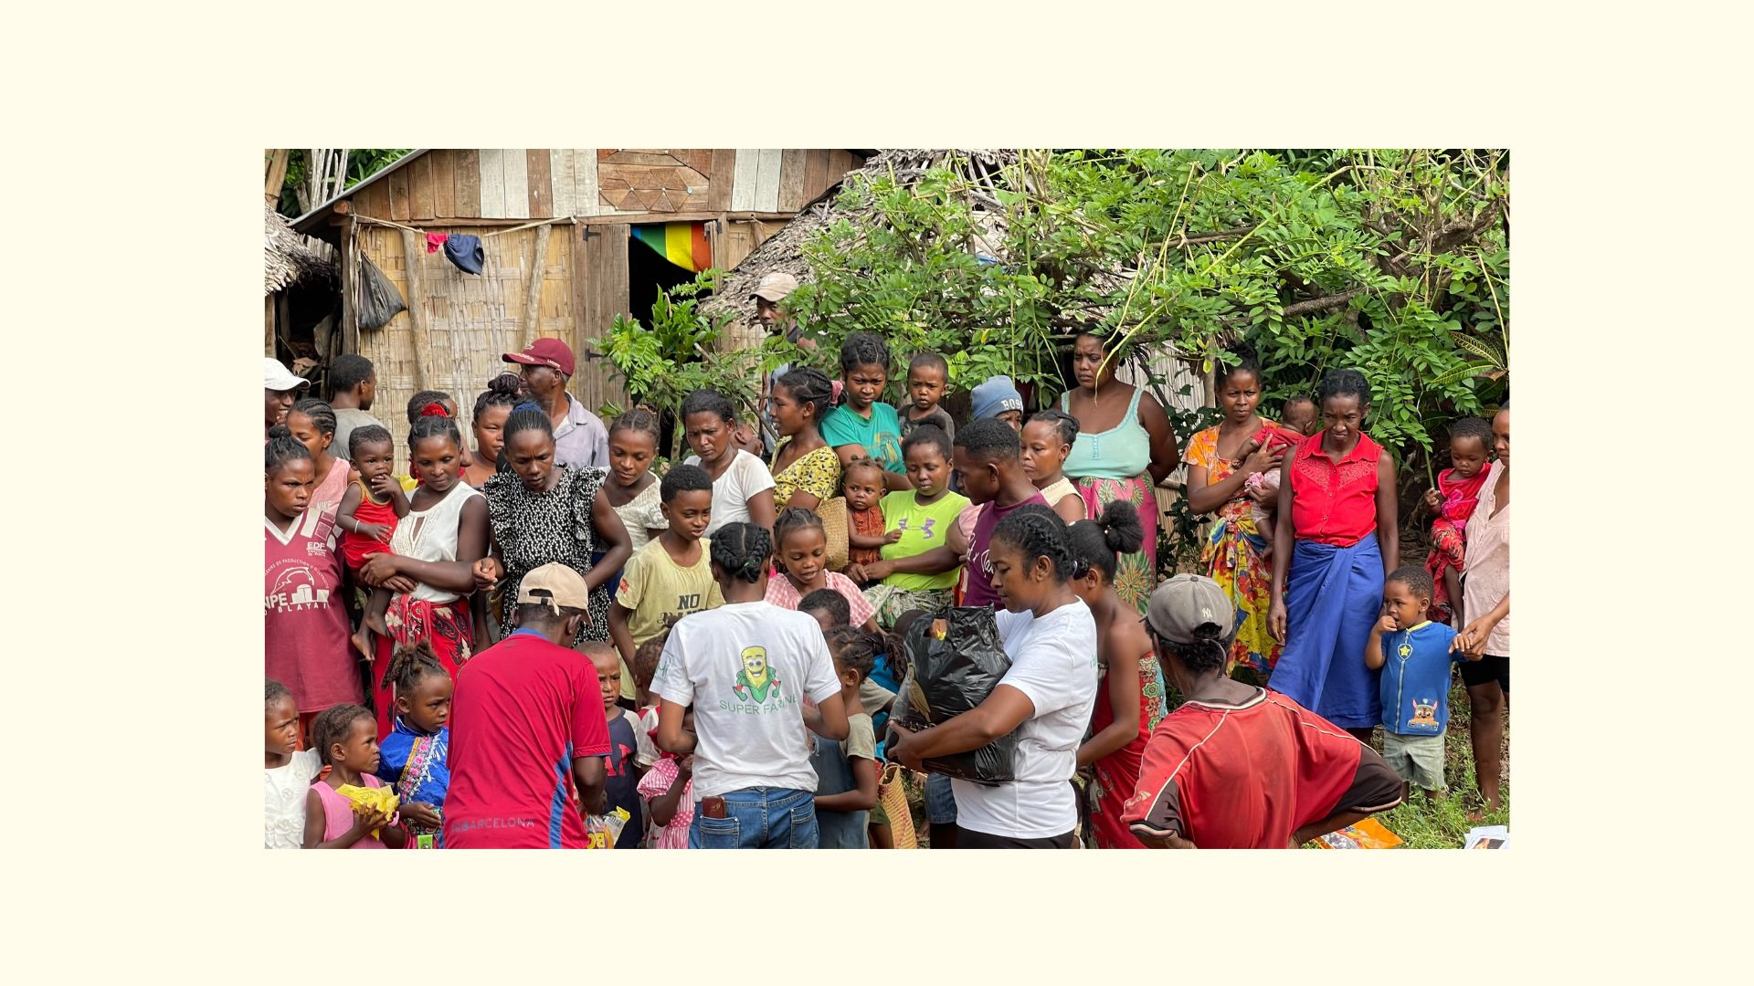

Slide 14
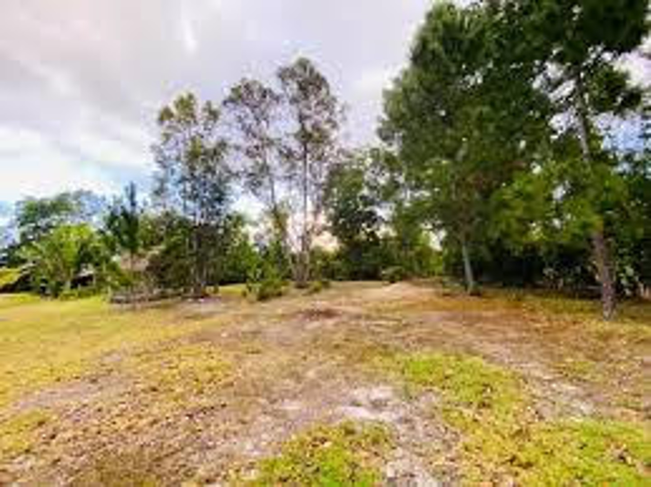
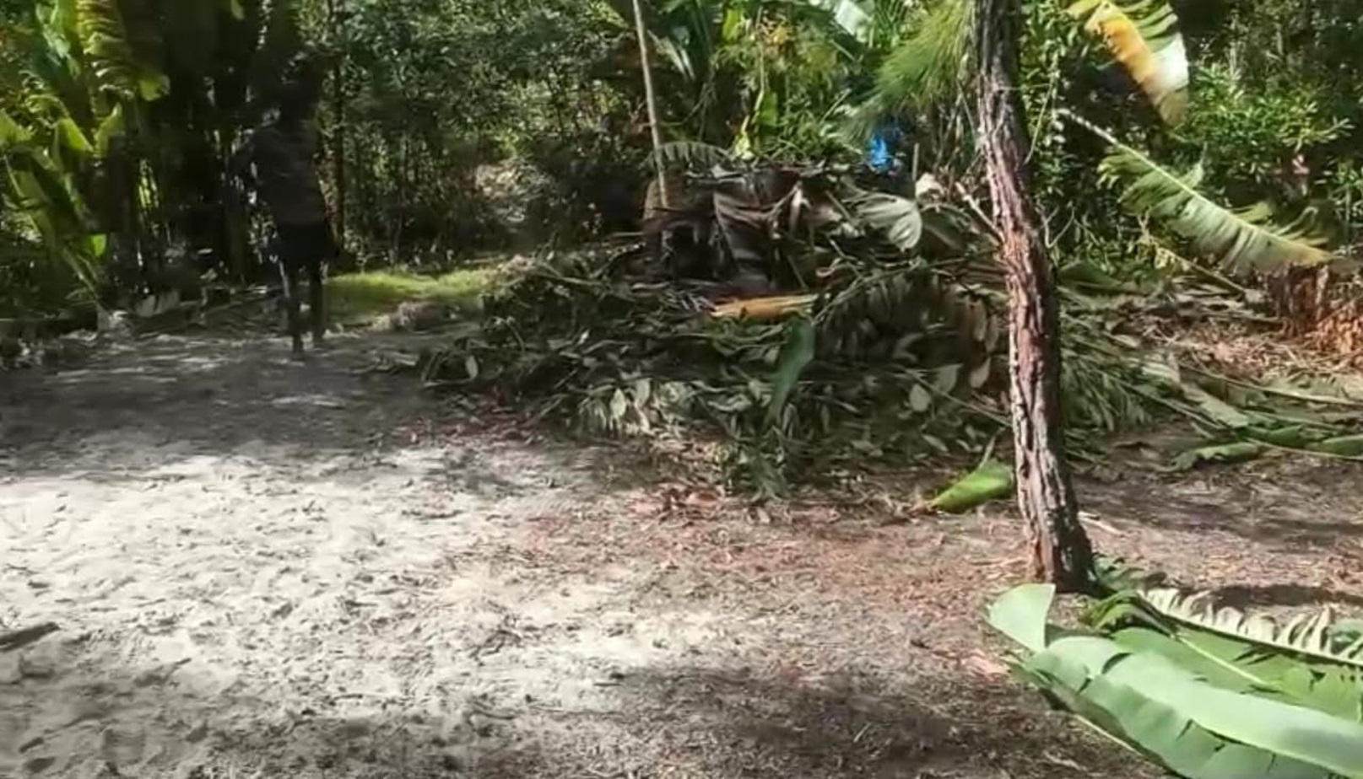

Slide 15
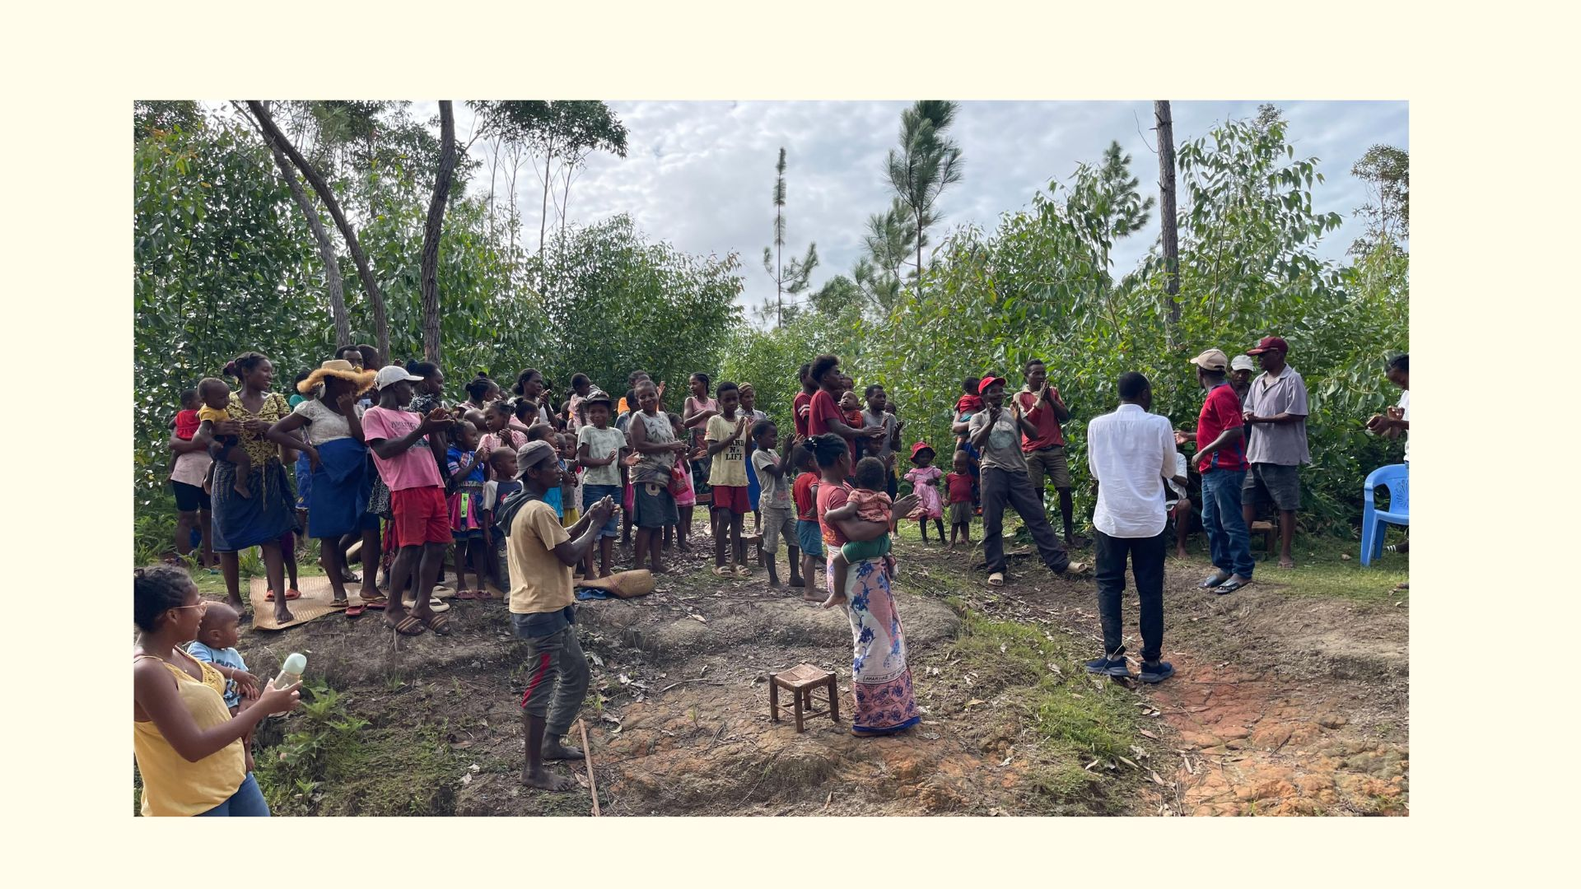

Slide 18
Sending peace and love
復活的盼望
馬可福音 15

Slide 19
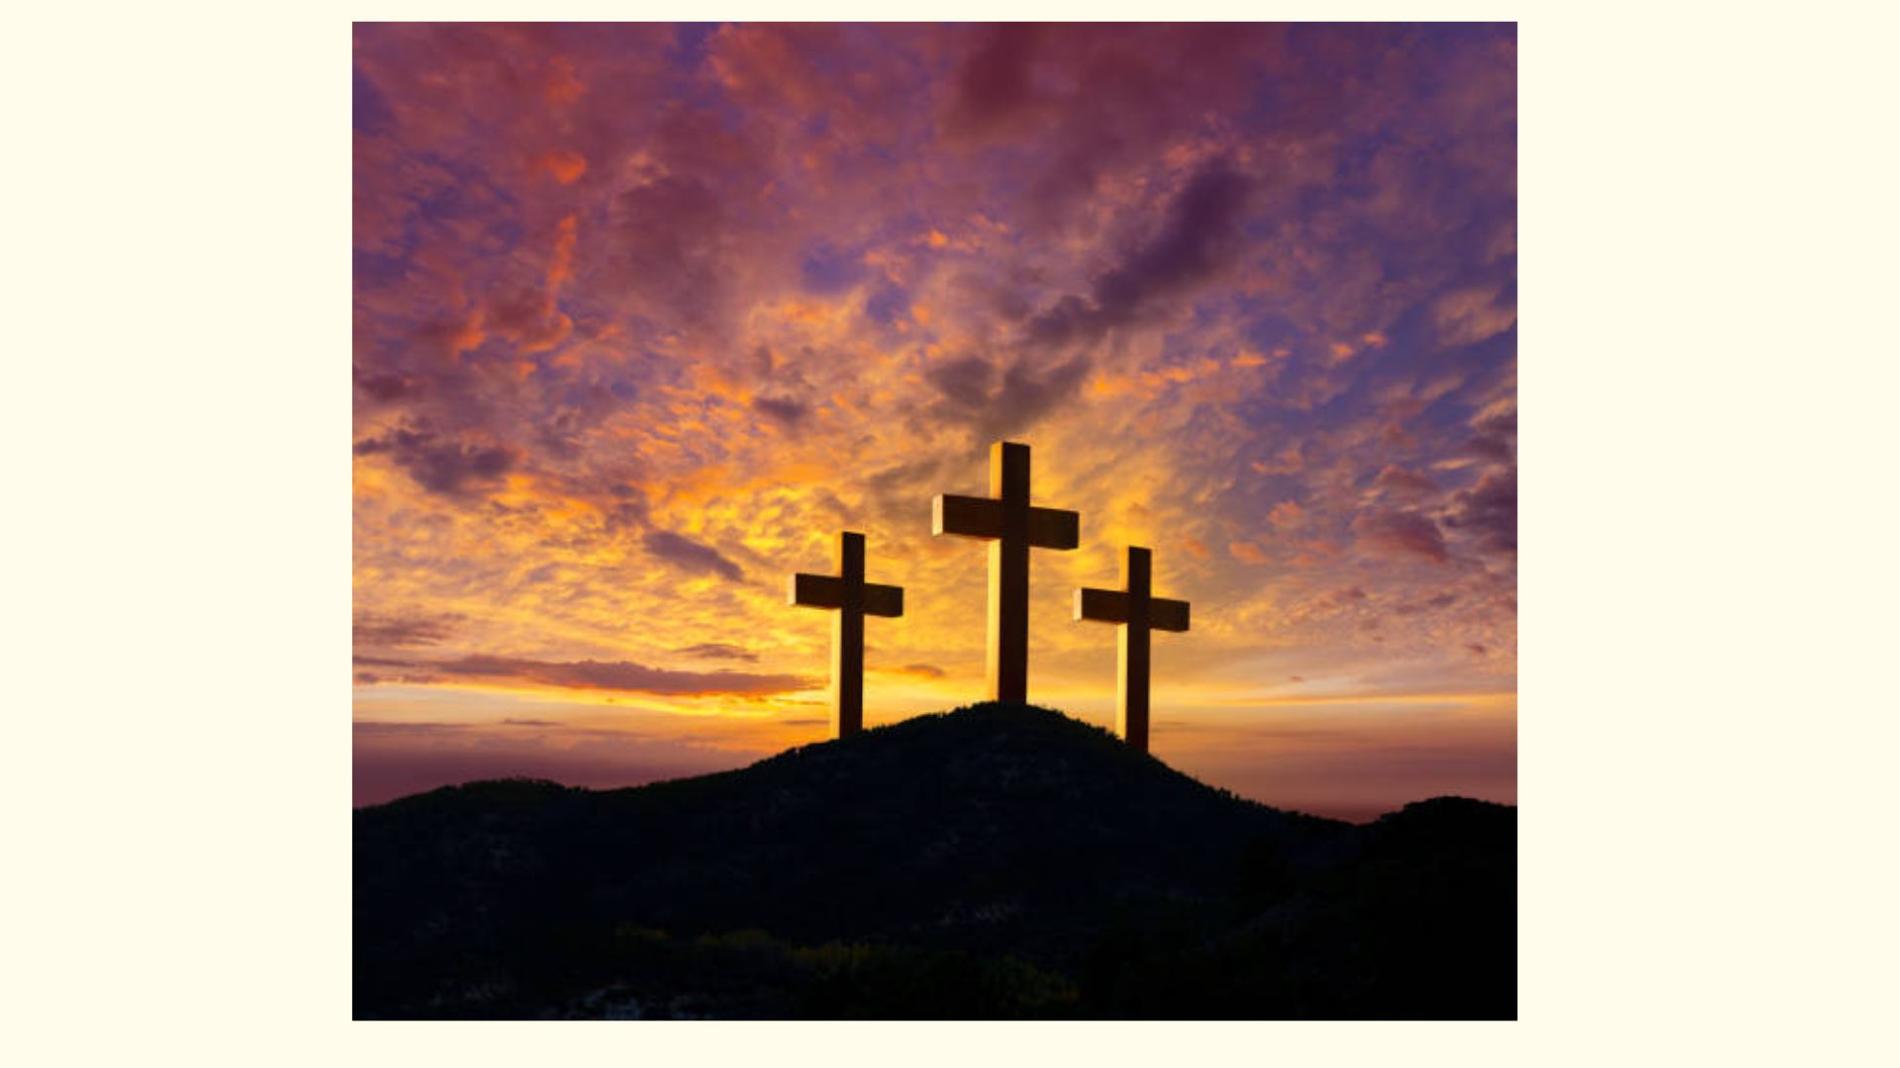

Slide 20
斷氣
Breathed his last

Slide 21
奇妙交換
Amazing Exchange
斷氣
Breathed his last

Slide 22
奇妙交換
Amazing Exchange
盼望來臨之前總是有一個黑暗時刻

Slide 23
盼望來臨之前總是有一個黑暗時刻
在還來得及時把事情做對了

Slide 24
在還來得及時把事情做對了
犧牲
Sacrifice

Slide 25
十字架下兩個人

Slide 26
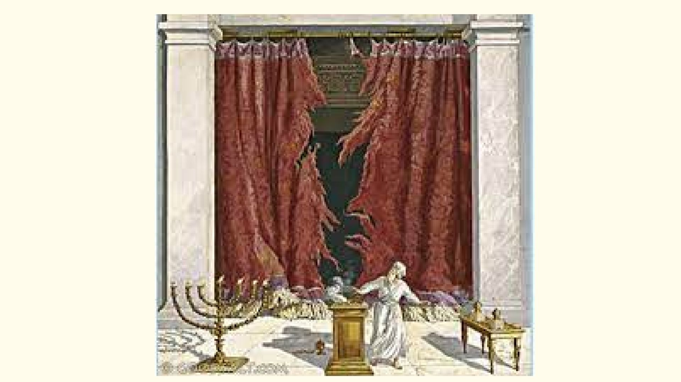

Slide 27
約翰福音 20:11 -12
11 馬利亞卻站在墳墓外面哭。哭的時候，低頭往墳墓裡看，12 就見兩個天使，穿著白衣，在安放耶穌身體的地方坐著，一個在頭，一個在腳。
11 Now Mary stood outside the tomb crying. As she wept, she bent over to look into the tomb 12 and saw two angels in white, seated where Jesus’ body had been, one at the head and the other at the foot.

Slide 29
“ 祂真是神的兒子！“
Surely He was the Son of God!

Slide 30
“ 祂真是神的兒子！“
Surely He was the Son of God!

