Slide 1
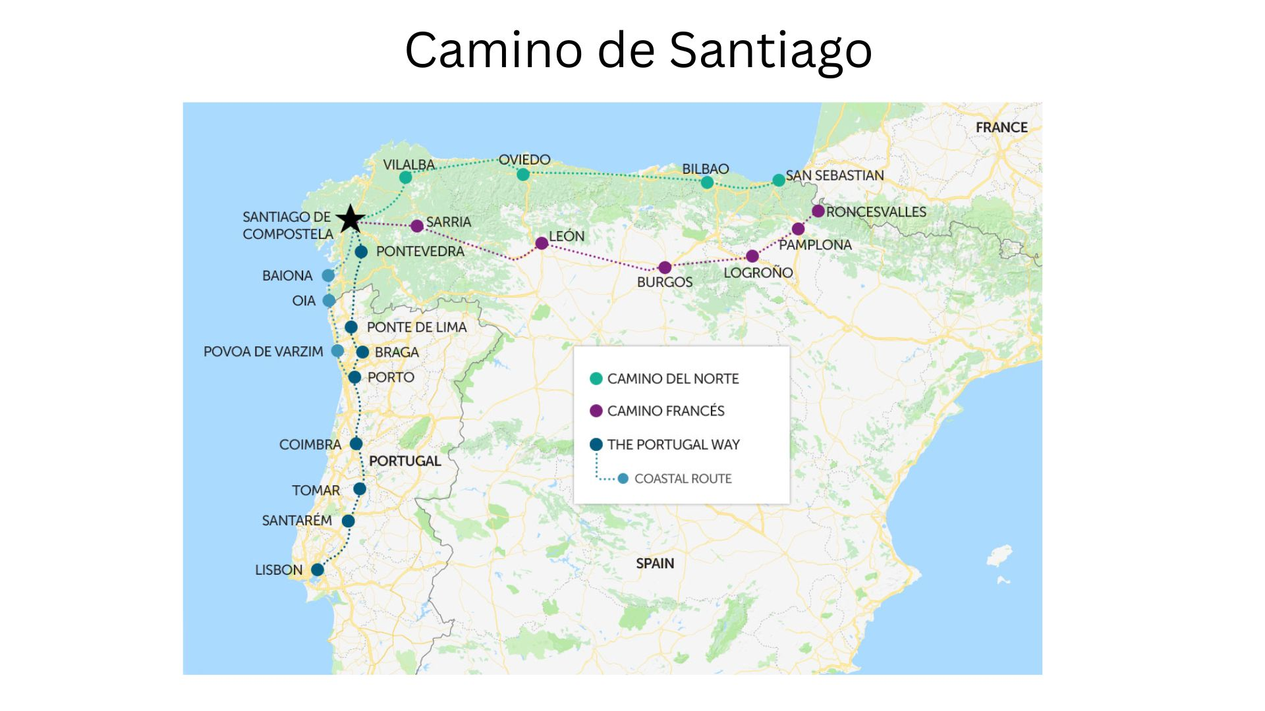

Slide 2
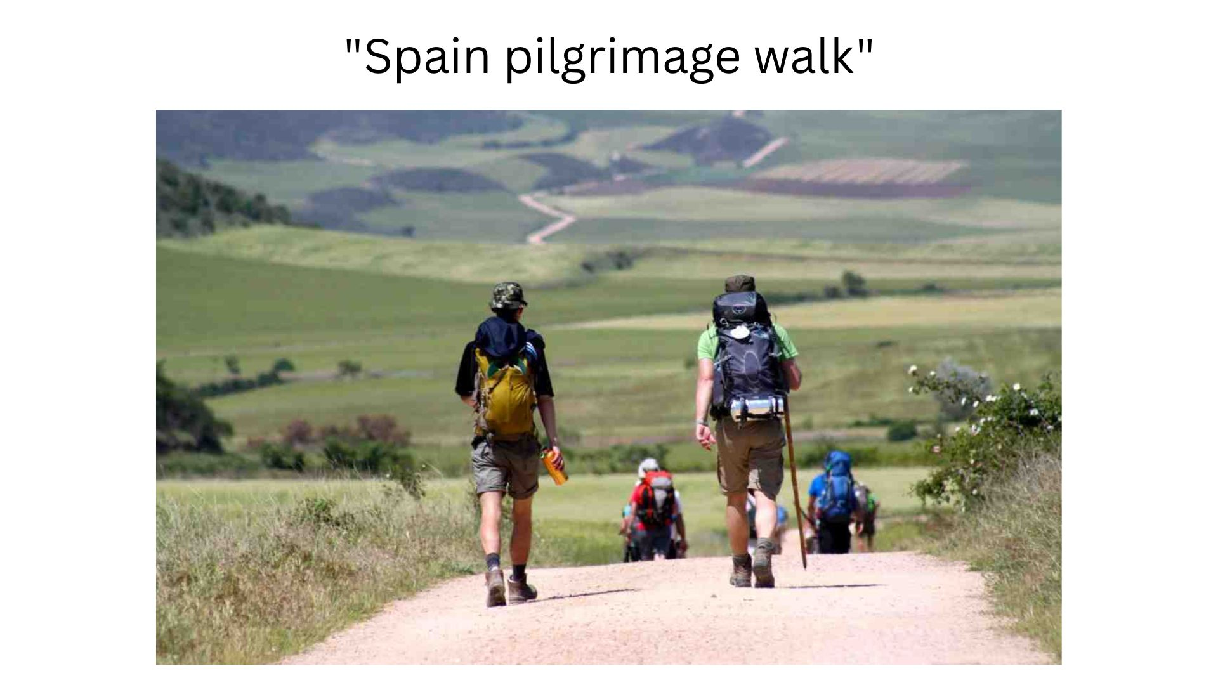

Slide 3




旅行者之歌 III
從冰冷到甦醒
From Feeble to Revive
創世記 45-47

Slide 4
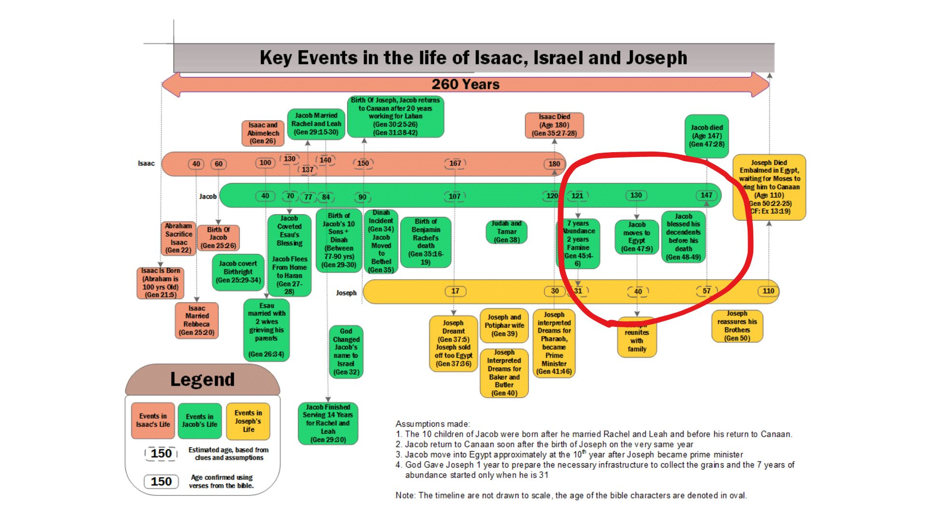

Slide 5
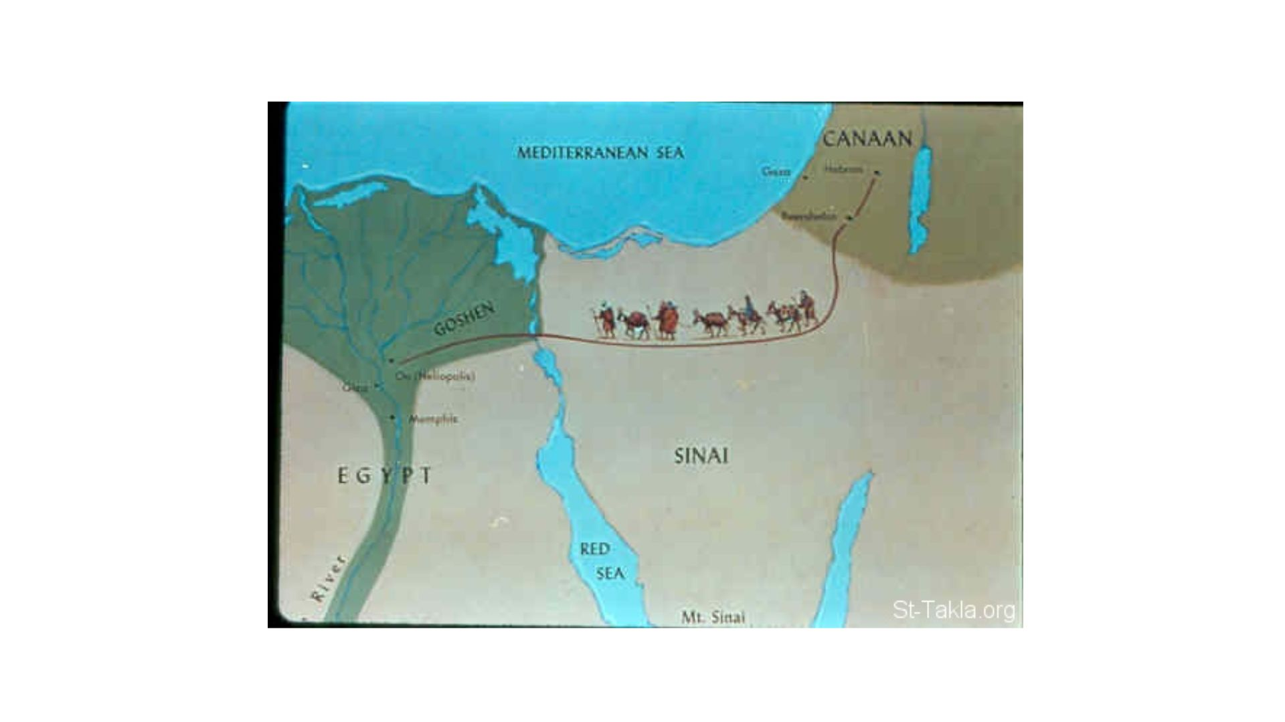

Slide 6
9 雅各對法老說：「我寄居在世的年日是一百三十歲。我平生的年日又少又苦，不及我列祖在世寄居的年日。
And Jacob said to Pharaoh, “The years of my pilgrimage are a hundred and thirty. My years have been few and difficult, and they do not equal the years of the pilgrimage of my fathers.”

Slide 7
Pilgrimage / Sojourning
人生的朝聖之旅
A pilgrimage is a sacred journey to a holy site, undertaken for religious devotion, spiritual growth, or to honor a significant person or event. The concept can also describe a personal quest or journey of profound meaning to a significant place. Pilgrimages serve as an inward spiritual renewal, where the physical journey parallels an inner one, offering a deeper connection to one's faith and a transformative encounter with the divine.

Slide 8
人生
是一個認識神的心靈之旅

Slide 9
雅各三次遇見神
青 - 夢見天梯
中 - 改名以色列
老 - 不要害怕下埃及

Slide 10
災難就是祝福的前奏

Slide 11
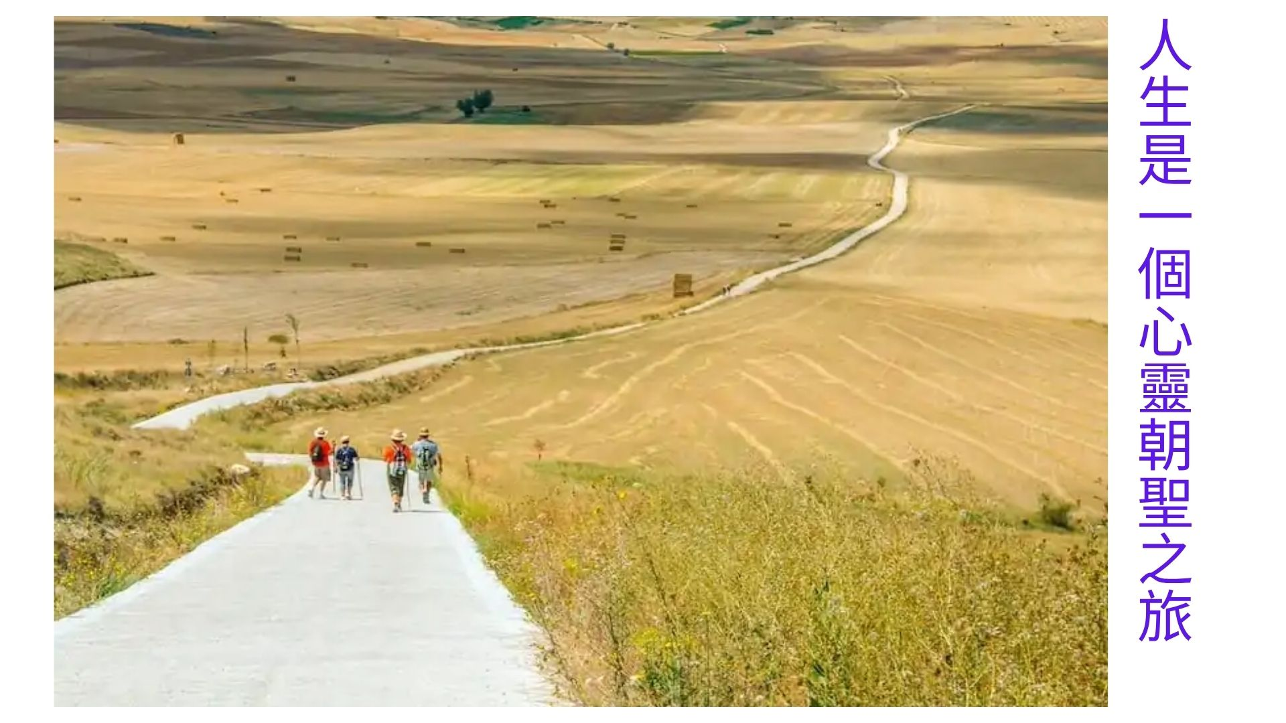

Slide 12
人生最後心事

Slide 13
生存的韌性
Rresilience

