Slide 1
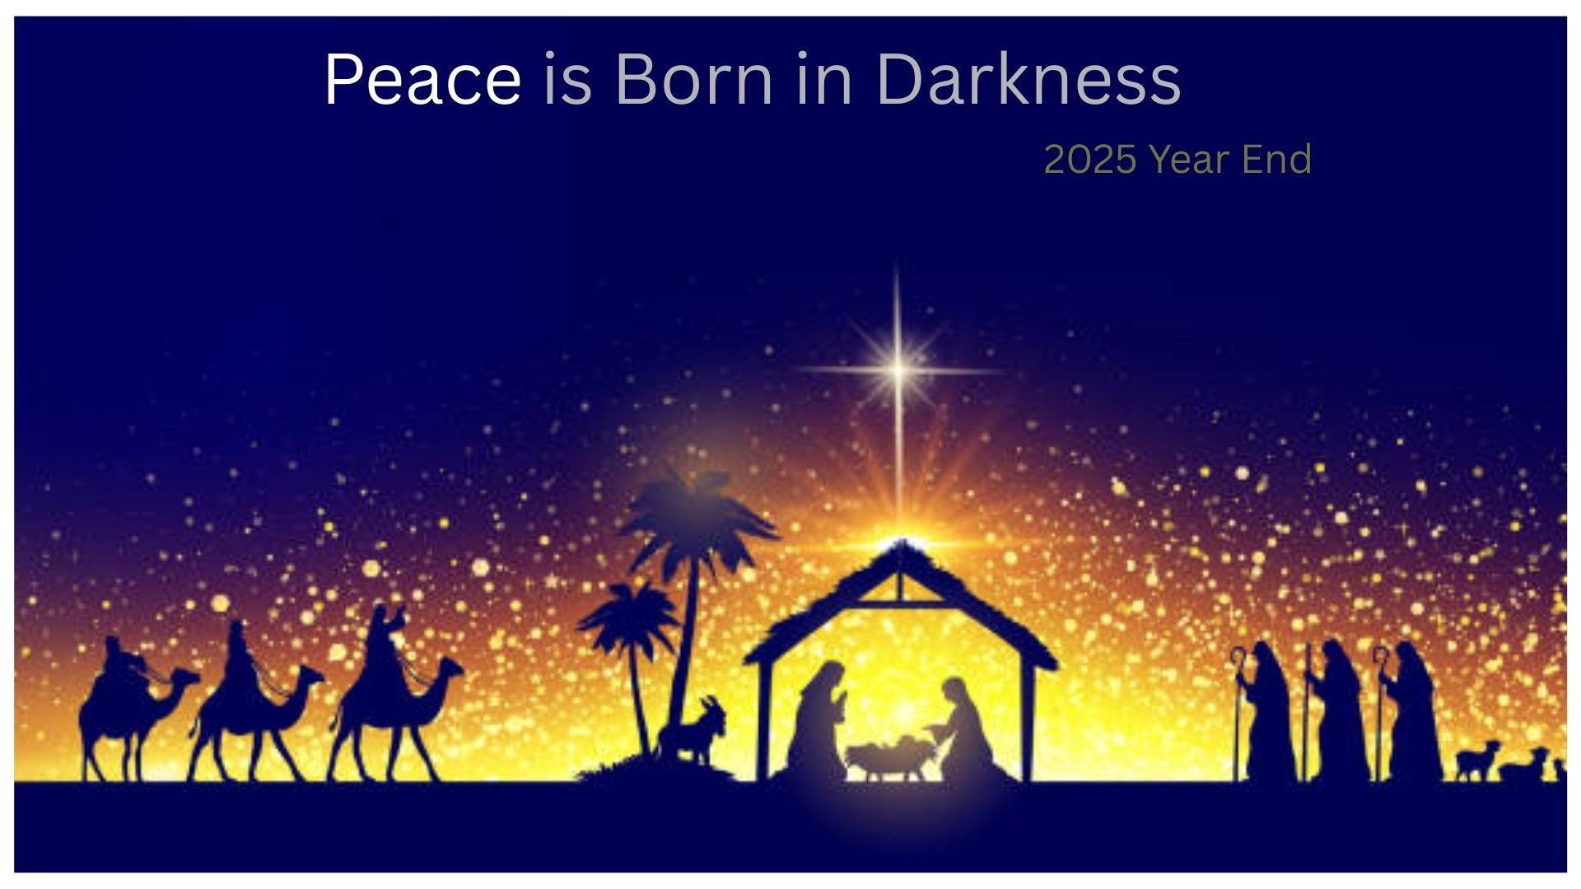

Slide 2


Slide 3


Slide 4


Slide 5
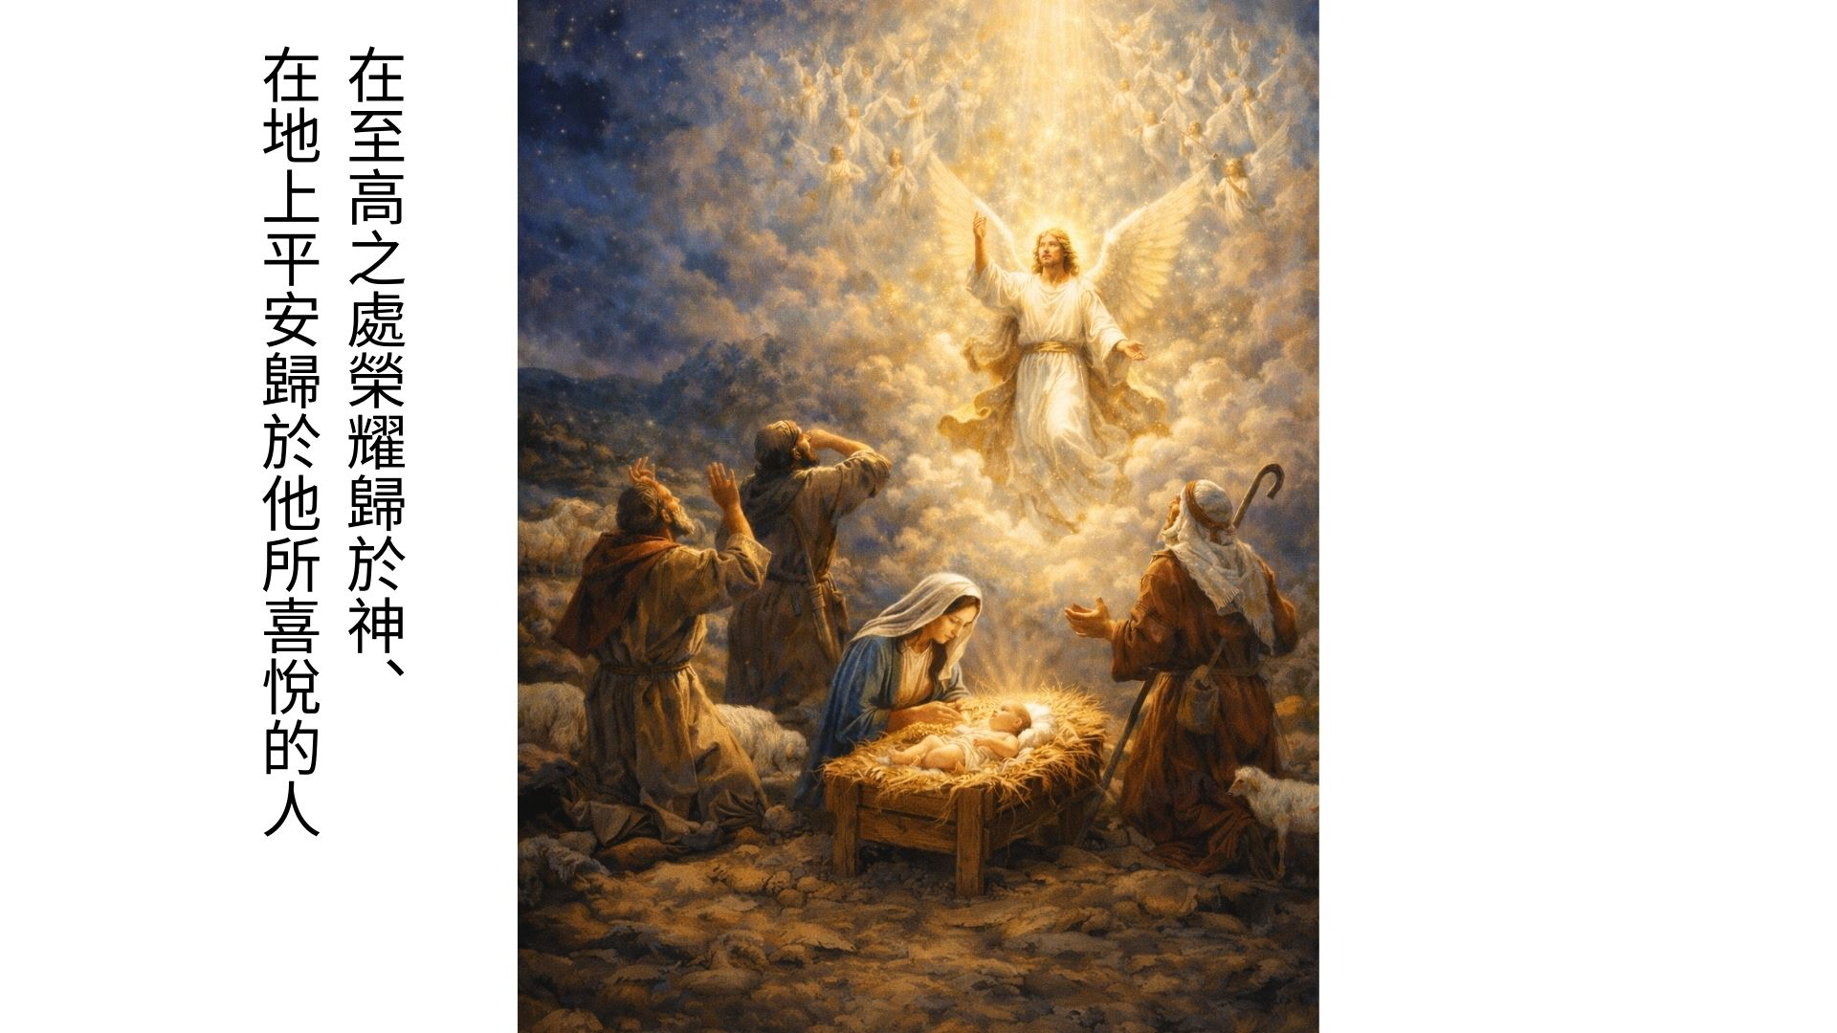

Slide 6
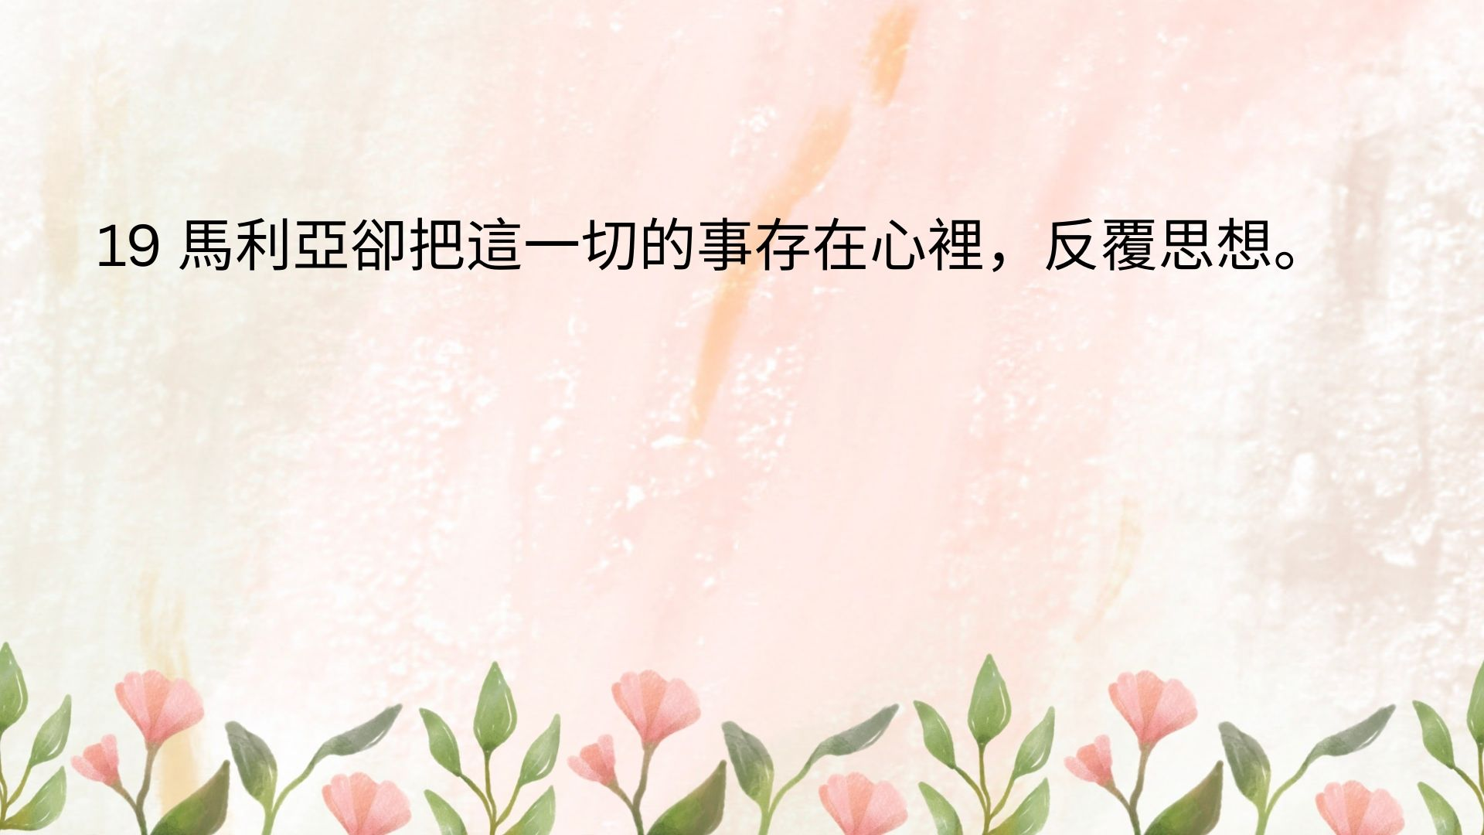

Slide 7
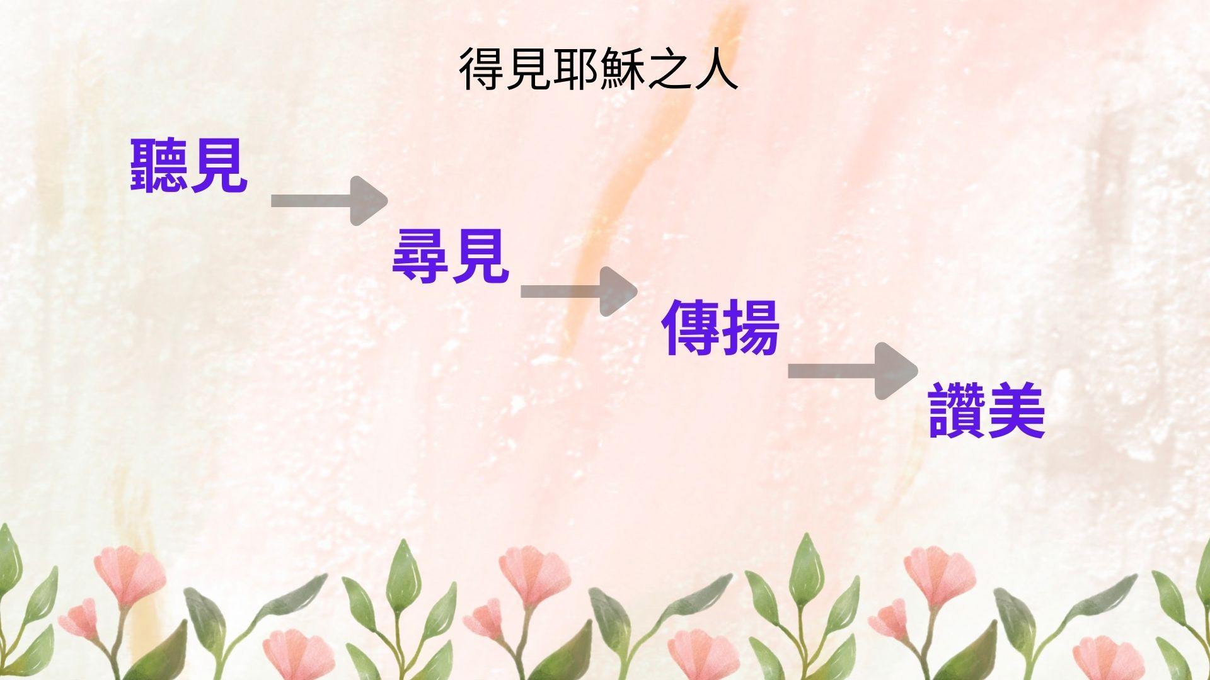

Slide 8


Slide 9
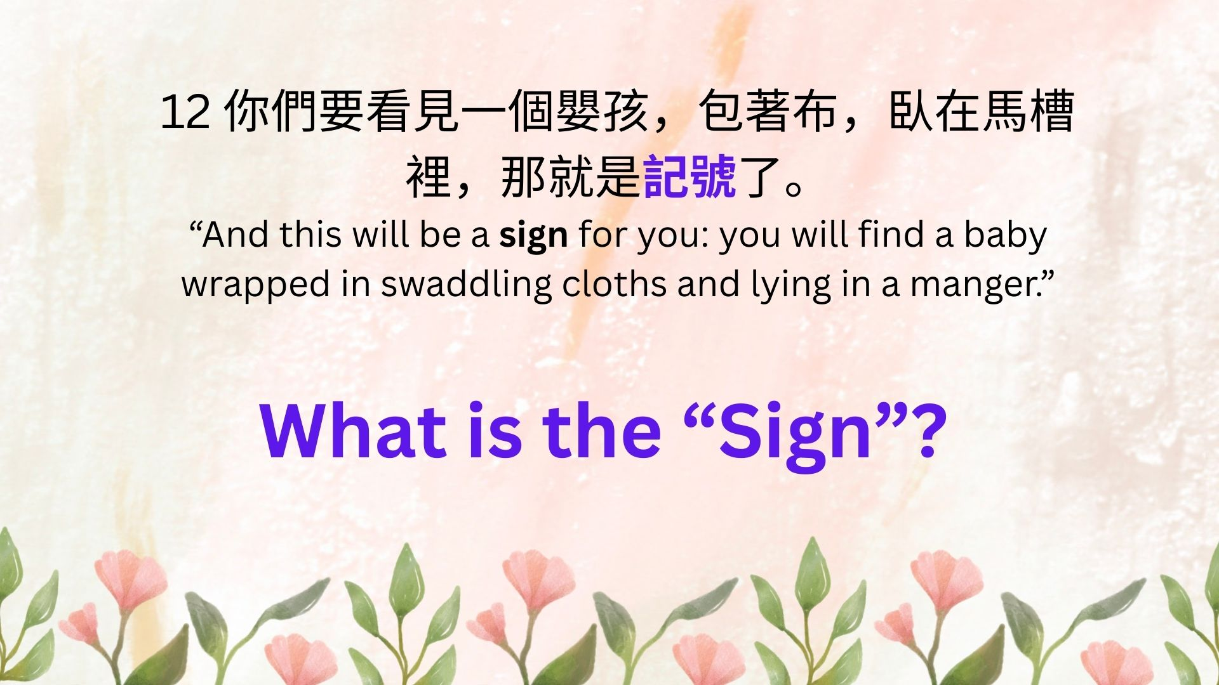

Slide 10

What is the Sign ? 記號
A Sign of Humility - 主是謙卑
A Sign for the Humble - 給謙卑者
A Sign of God’s Reversal - 神恩奇妙
A Sign of approachable - 人人可來
A Sign that needs Faith - 需要信心

Slide 11


