Slide 1


Slide 2
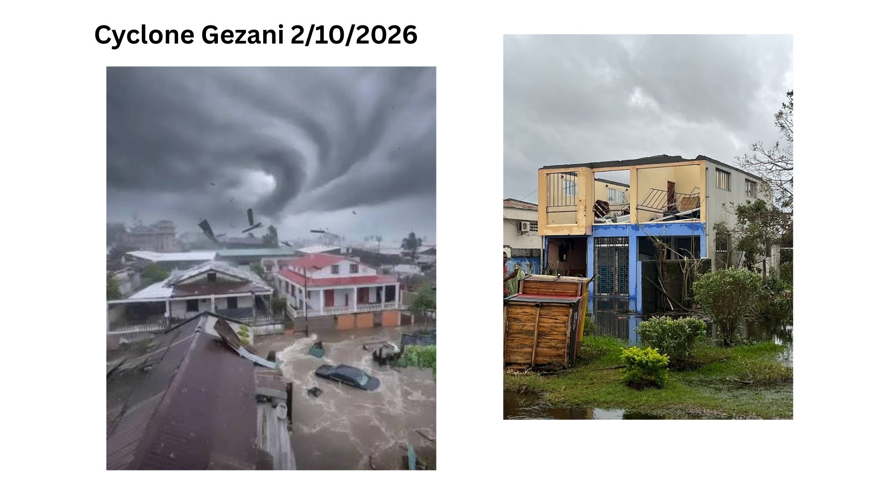

Slide 3


Slide 4
教堂落成紀念碑
This church shall stand as a lasting place of worship, prayer, education, and community development—a beacon of faith and hope for generations to come.
Dedicated on February 24, 2026
“More importantly, A Shelter in the Storm”.

Slide 5


Slide 6
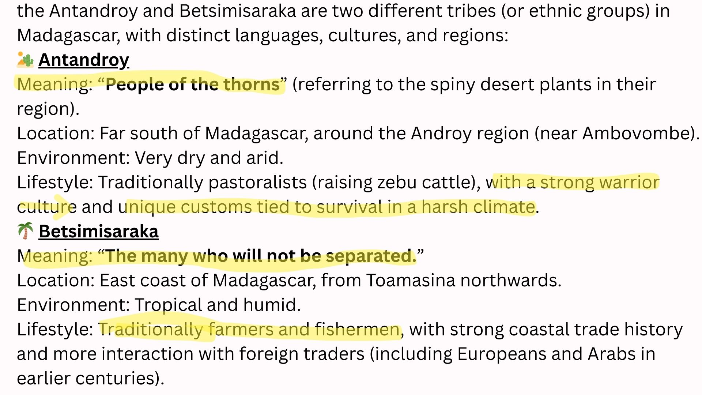

Slide 7


Slide 8


Slide 9
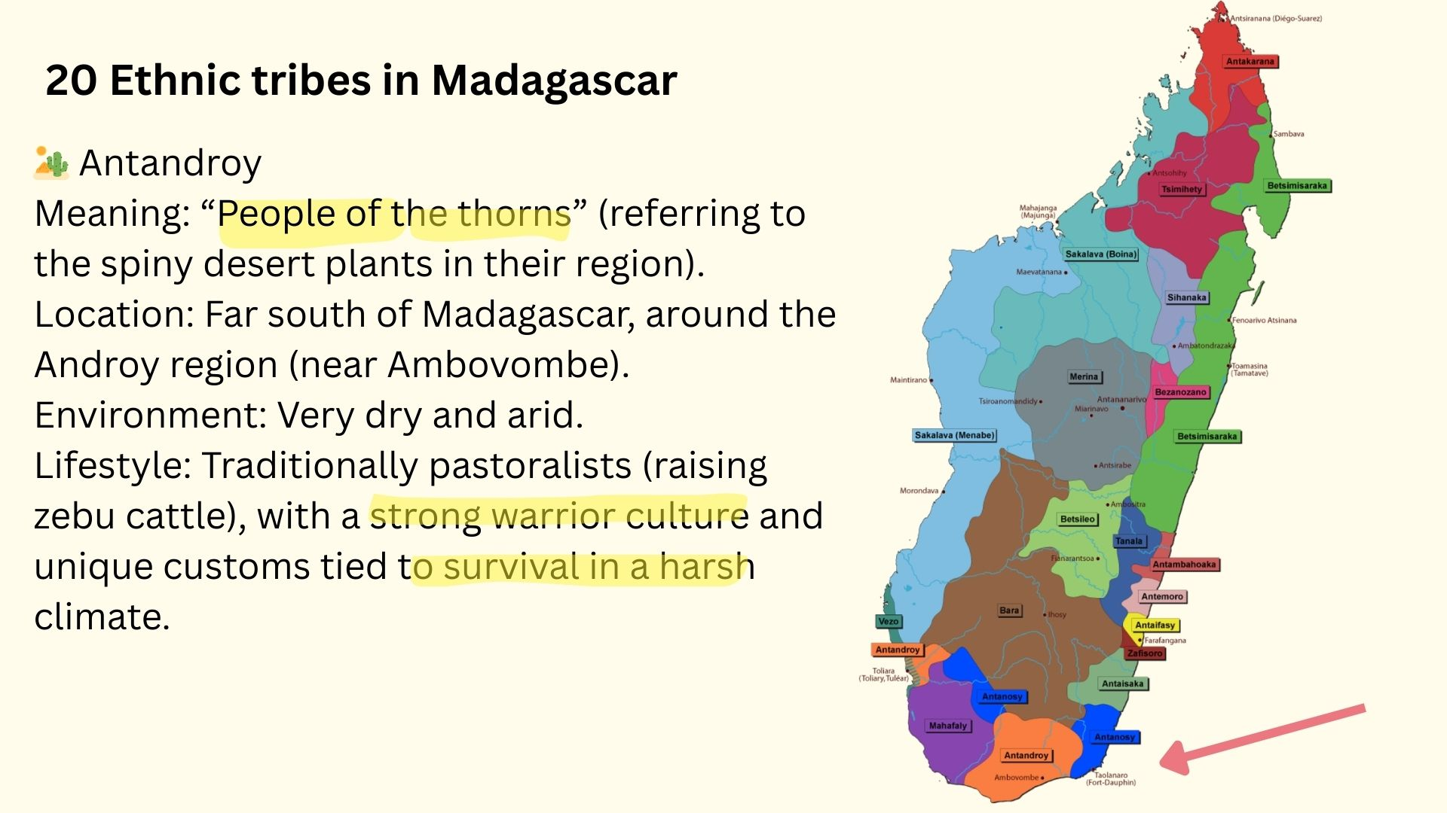

Slide 10


Slide 11
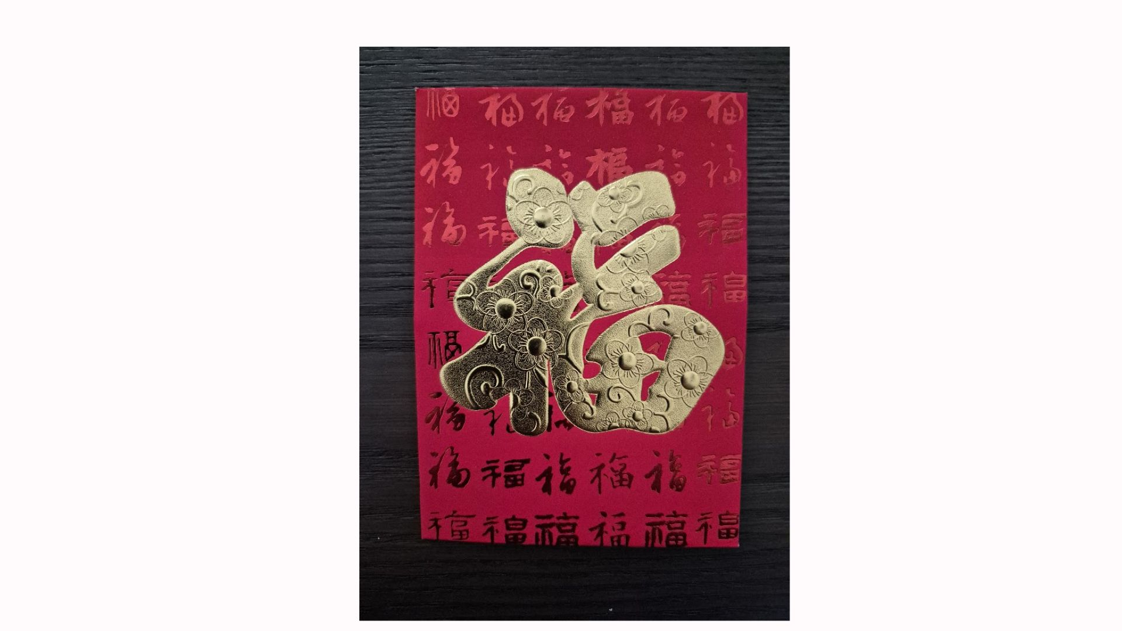

Slide 12


Slide 13


Slide 14


Slide 15


Slide 16


Slide 17


Slide 18


Slide 19


Slide 20


Slide 21


