Slide 1
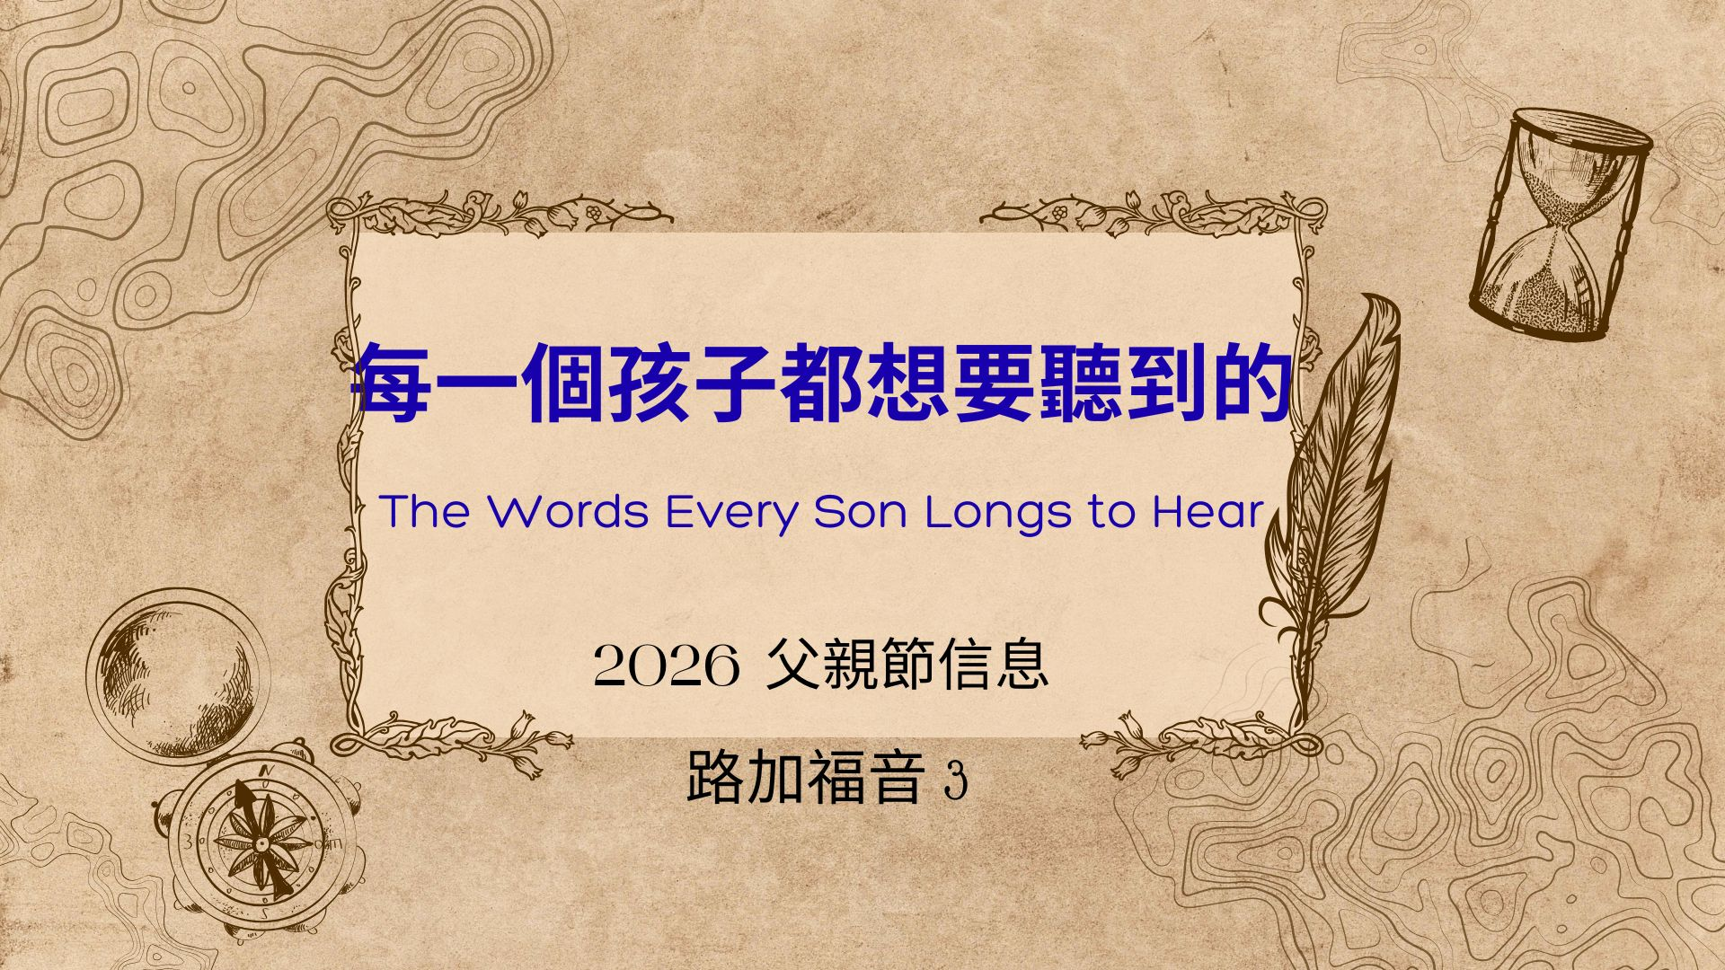

Slide 2
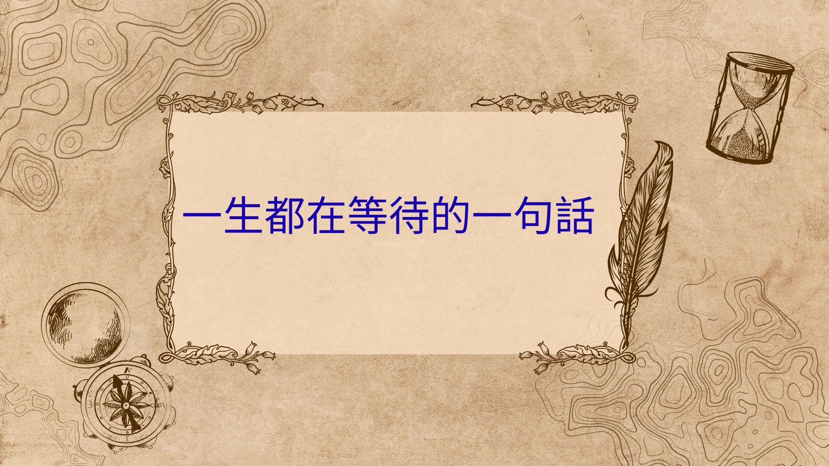

Slide 3
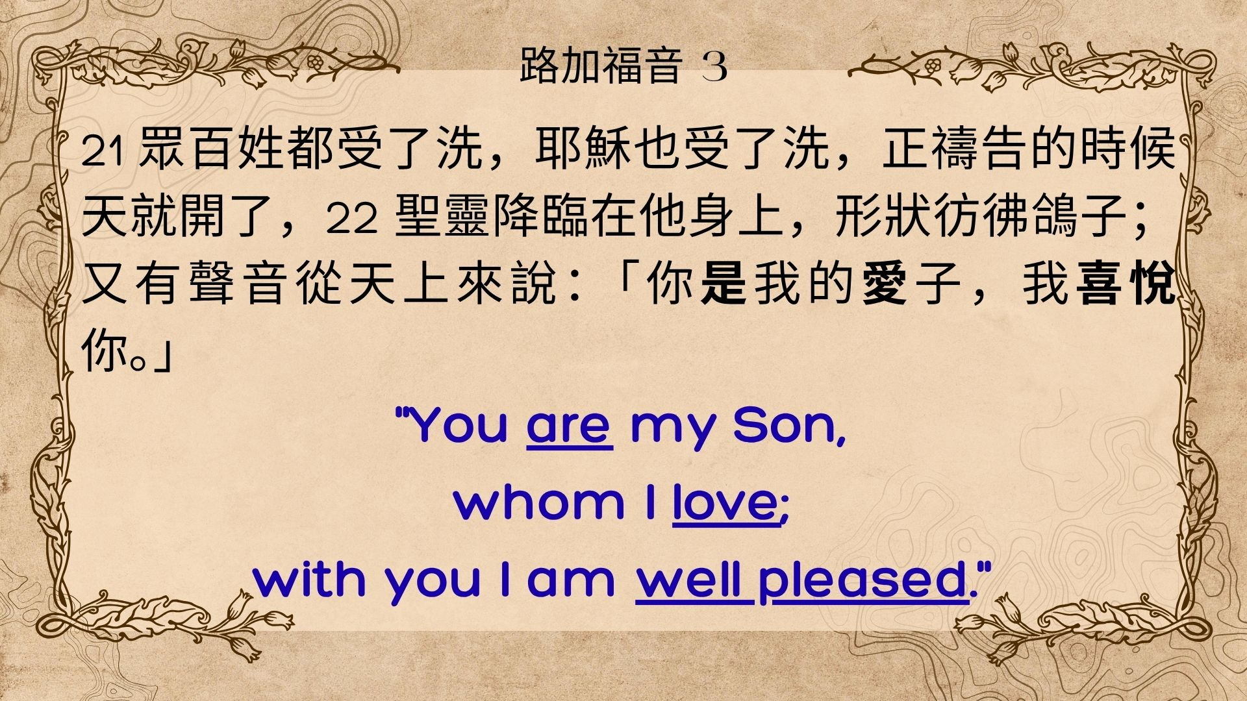

Slide 4
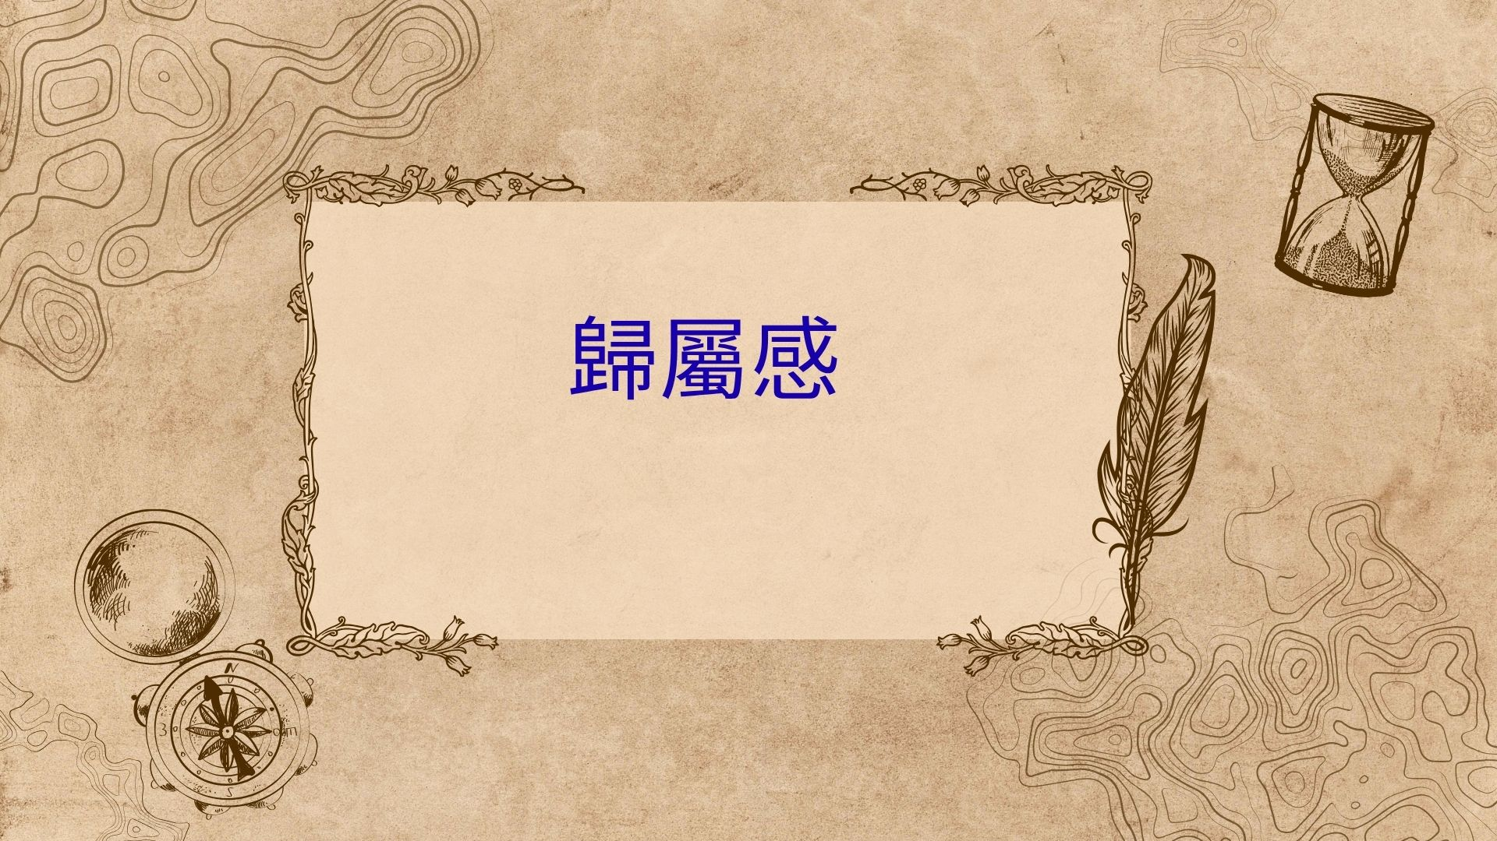

Slide 5

健全人格三要素
  1.身份認同 “You are my Son” -The Gift of Identity
  自我價值和自信心
  知道人生方向
  不怕失敗
  2.知道被愛 “Whom I Love” - The Gift of Love
  心中有倚靠
  3.被肯定 “with you I am well pleased” - The Gift of Approval

Slide 6
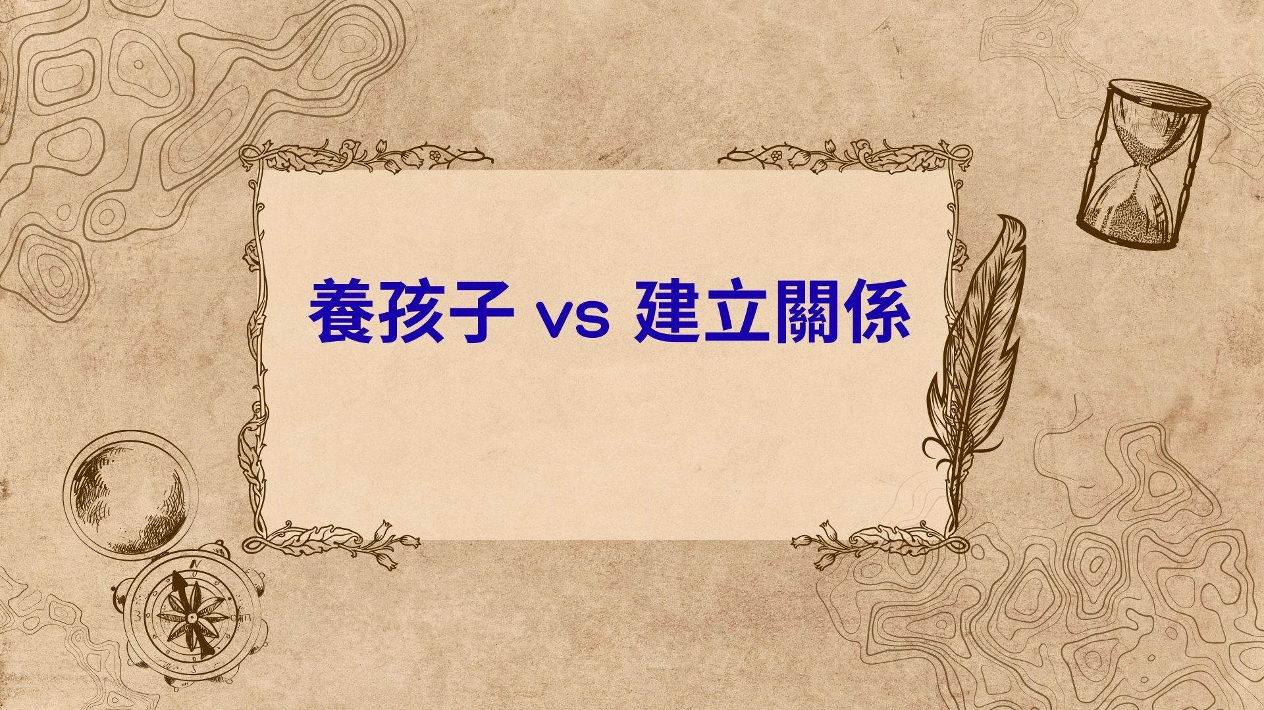

Slide 7
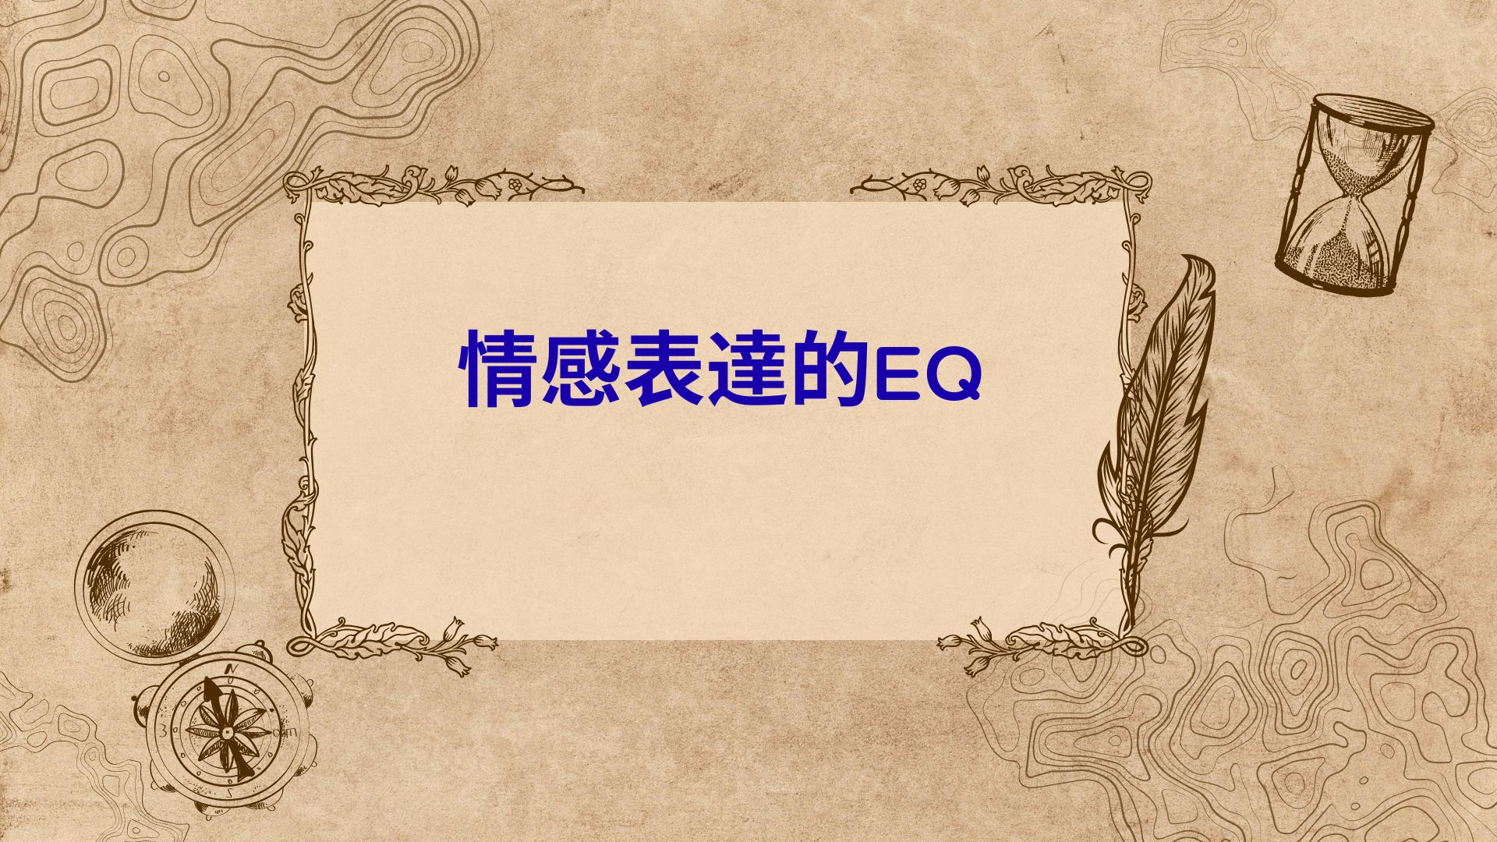

Slide 8
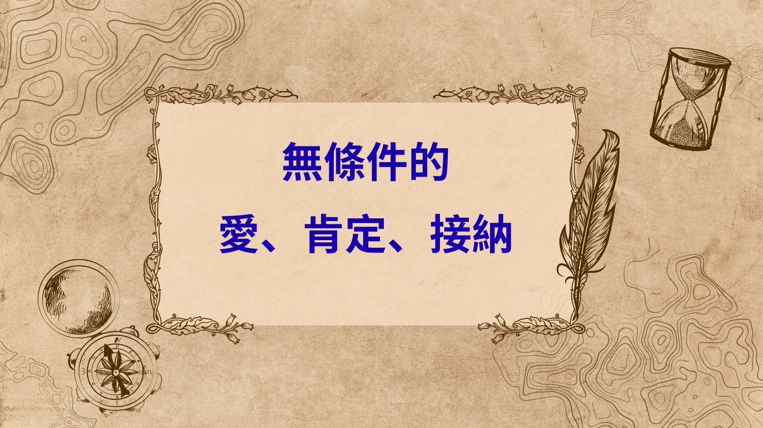

Slide 9
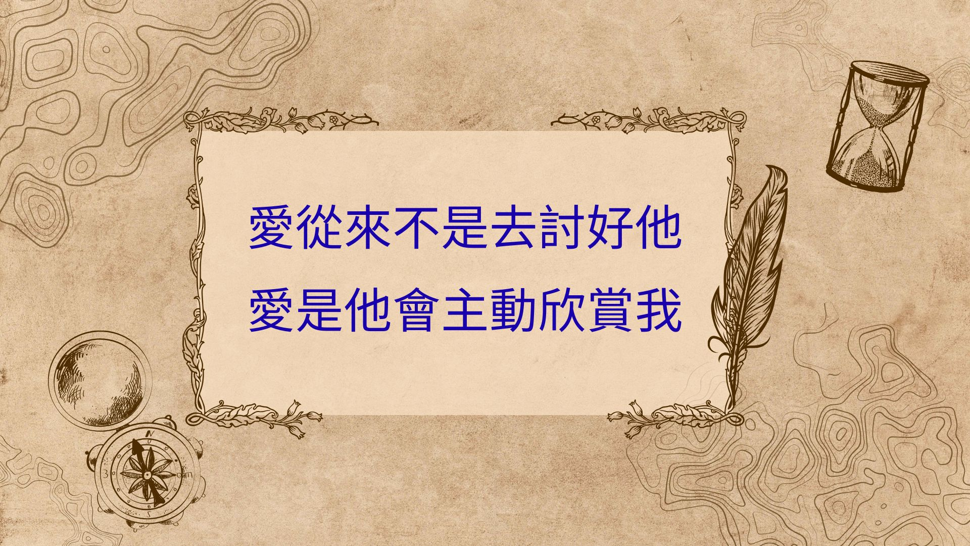

Slide 10
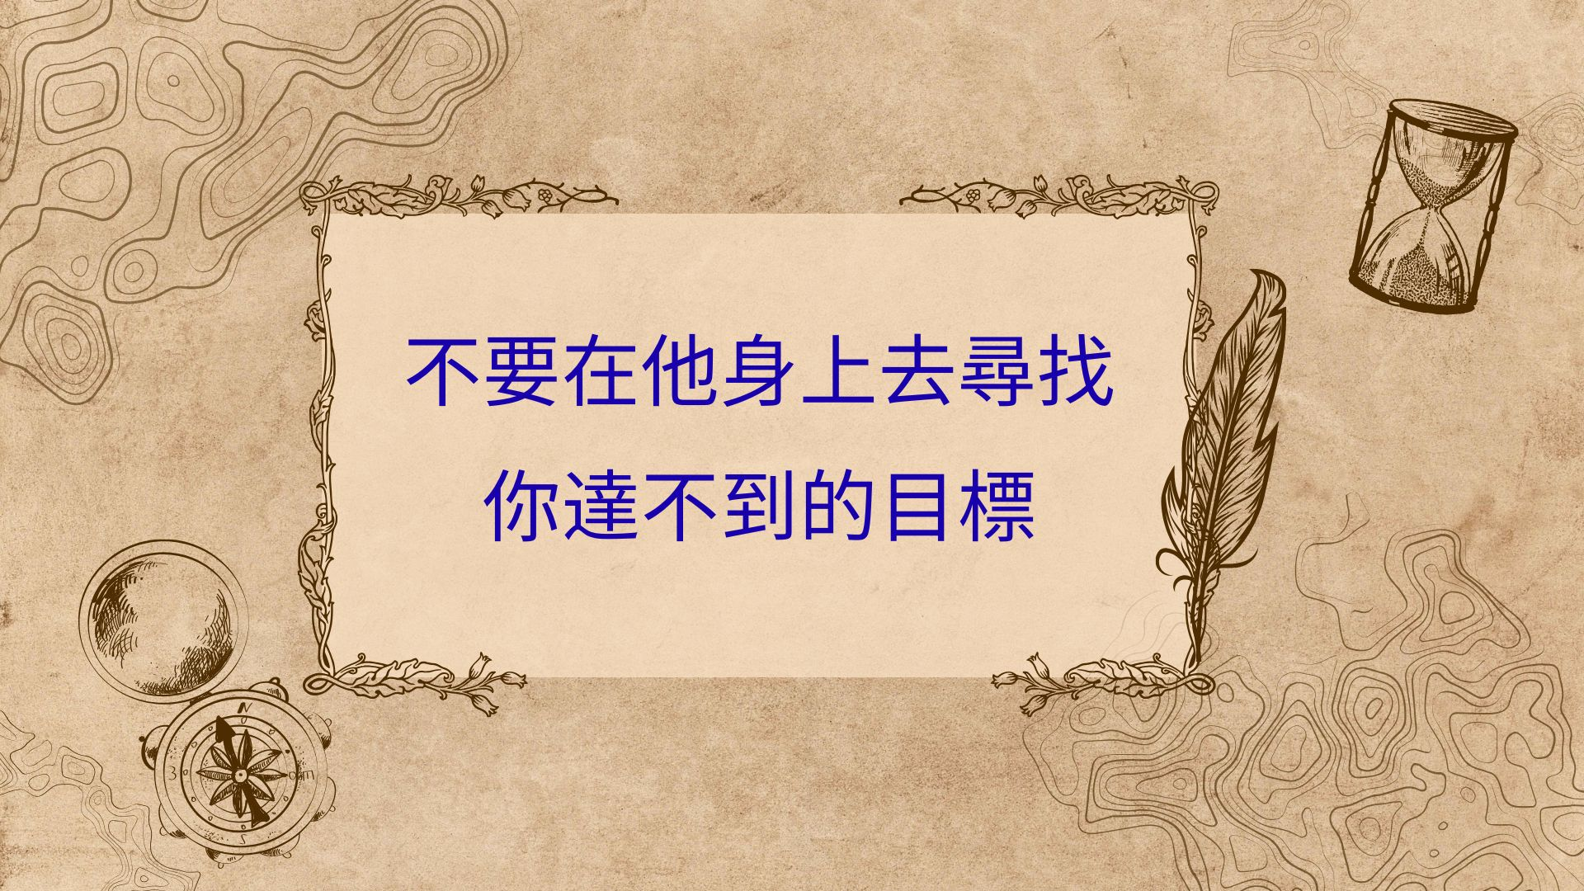

Slide 11
